Slide 1
Graph Signal Processing
Master’s Project – EPFL Communication Systems
Kaan Okumus
2023

Slide 2
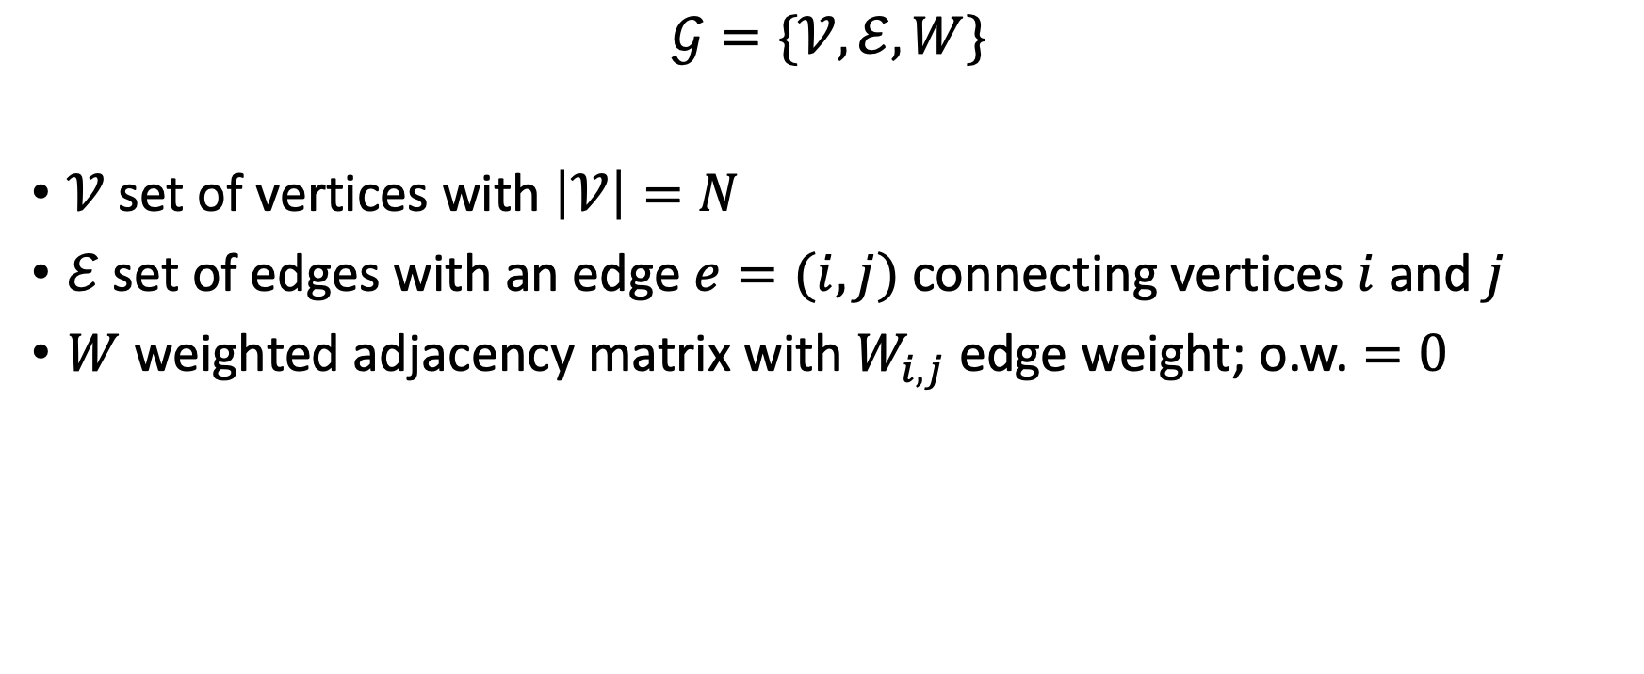
Graphs
$$𝒢=\{𝒱, ℰ,W\}$$
$𝒱$set of vertices with $\left|𝒱\right|=N$
$ℰ$ set of edges with an edge $e=(i,j)$ connecting vertices $i$ and $j$
$W$ weighted adjacency matrix with $W_{i,j}$ edge weight; o.w. $=0$

Slide 3
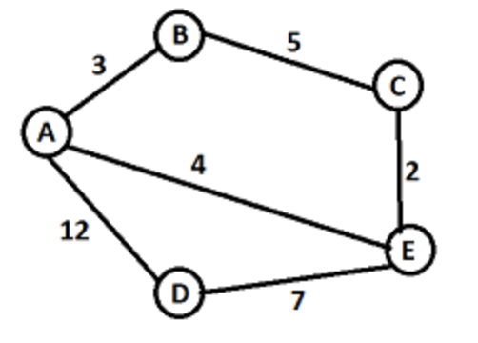
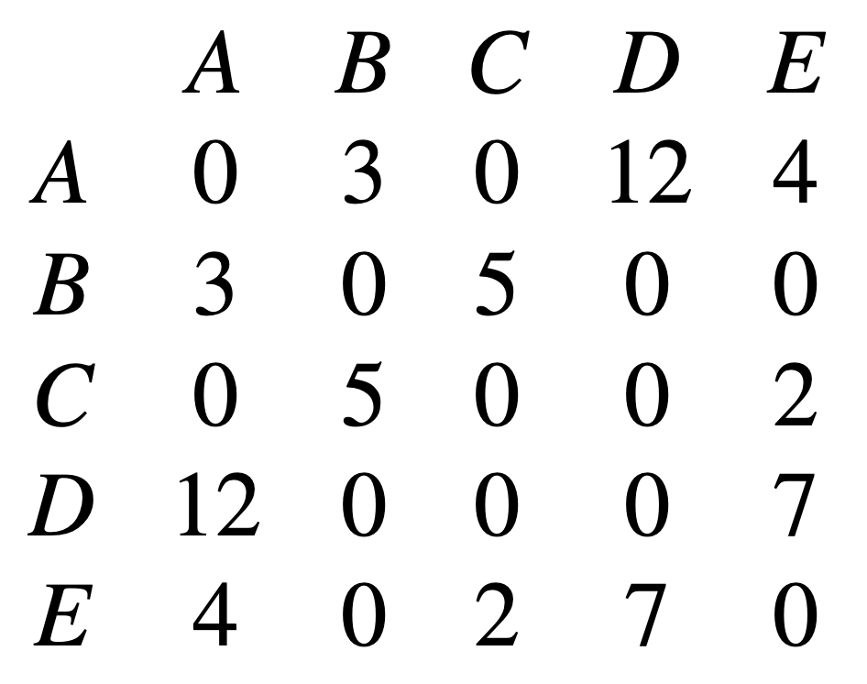
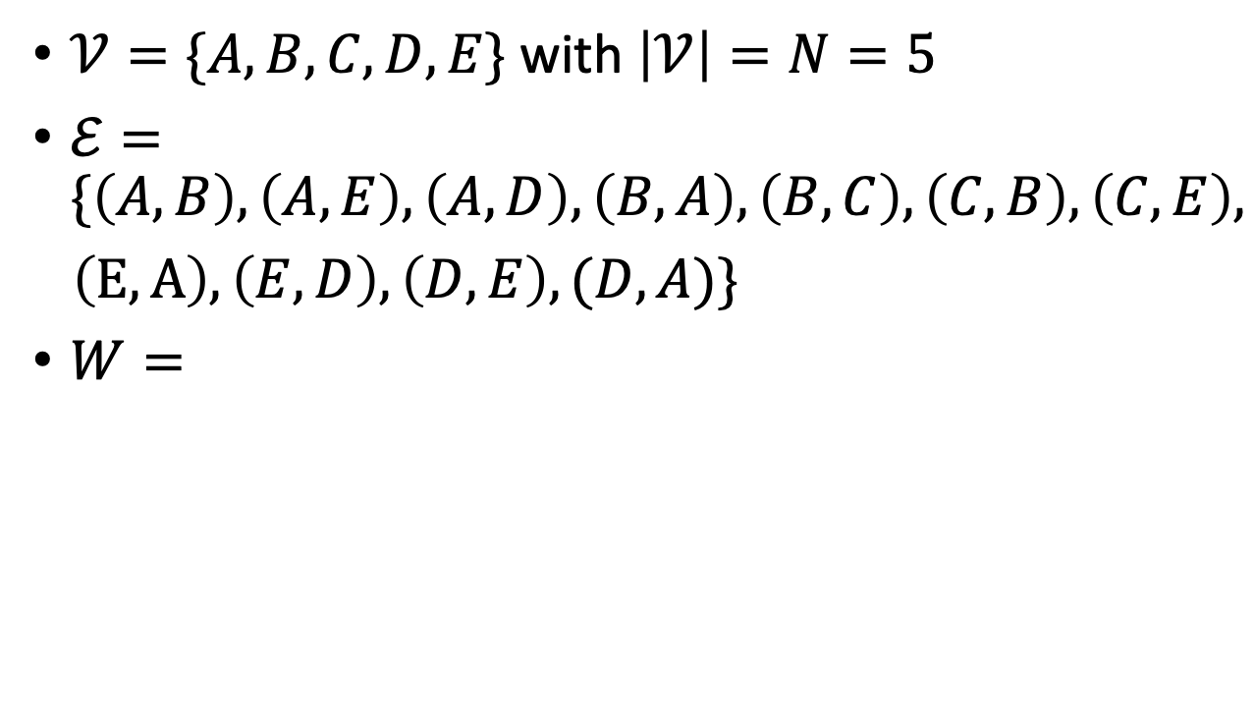
Graphs
$𝒱=\{A,B,C,D,E\}$ with $\left|𝒱\right|=N=5$
$ℰ=\{\left(A,B\right), \left(A,E\right),\left(A,D\right),\left(B,A\right),\left(B,C\right), \left(C,B\right),\left(C,E\right),$
$\left(E,A\right),\left(E,D\right), \left(D,E\right),(D,A)\}$
$W=$

Slide 4
Graph Types
Directed vs Undirected
Null graph: no edges
Simple graph: no loops and multiple edges, undirected
Multi-graph: if same sets of vertices contain multiple edges
Connected vs Disconnected
Cycle graph
Complete graph: if each pair of vertices is connected with the help of exactly one edge
Planer vs non-planer

Slide 5
Special Graphs
Tree: undirected graph that can have only one path to connect any two vertices, cannot have loops and cycles
Degree
Cycle
Bipartite graph: 2 independent sets which contain the set of vertices, where the vertices of the graph is connected in such a way that each edge can have a connection from the first set to the second set
Complete bipartite graph
Hypercube

Slide 6
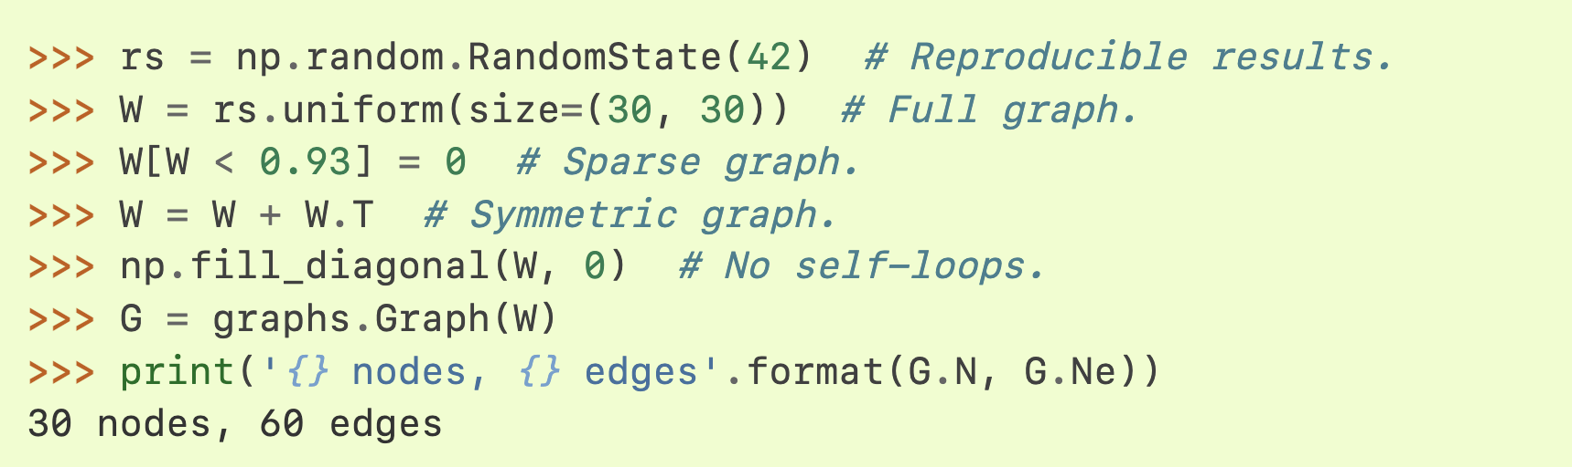
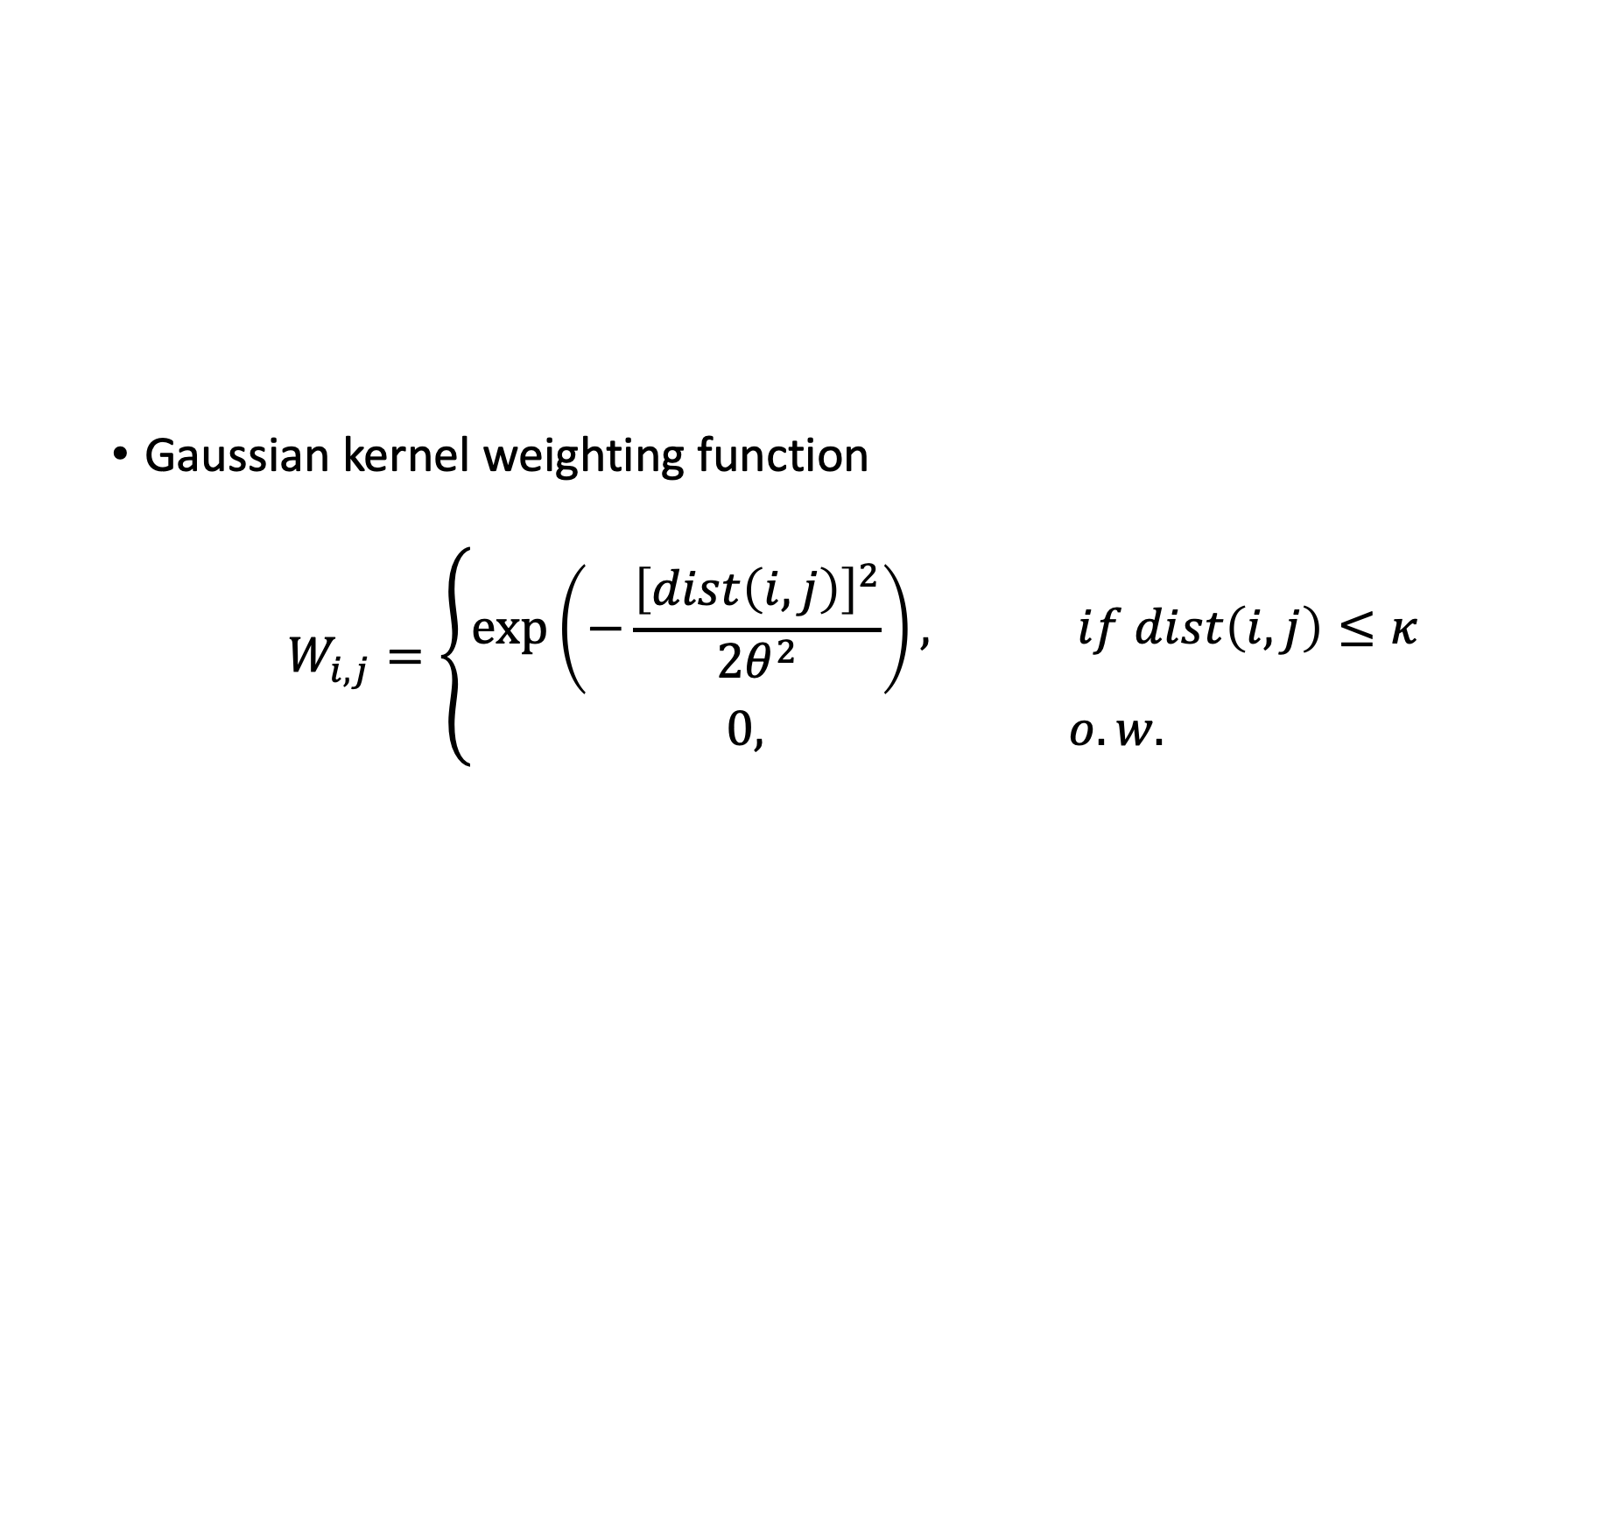
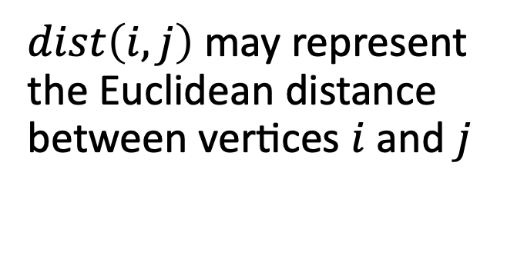
Graph Construction Method
Gaussian kernel weighting function
$$W_{i,j}=\left\{\begin{aligned}\exp\left(−\frac{{\left[dist\left(i,j\right)\right]}^{2}}{2θ^{2}}\right), if dist\left(i,j\right)≤κ \\ 0, o.w.\end{aligned}\right.$$
$dist\left(i,j\right)$ may represent the Euclidean distance between vertices $i$ and $j$

Slide 7
Graph Construction Method
Edges from K-Nearest Neighbors Method: connect each vertex to its k-nearest neighbors based on distances
Edges from Delaunay triangulation
Edges via Watts-Strogatz Model
etc.

Slide 8
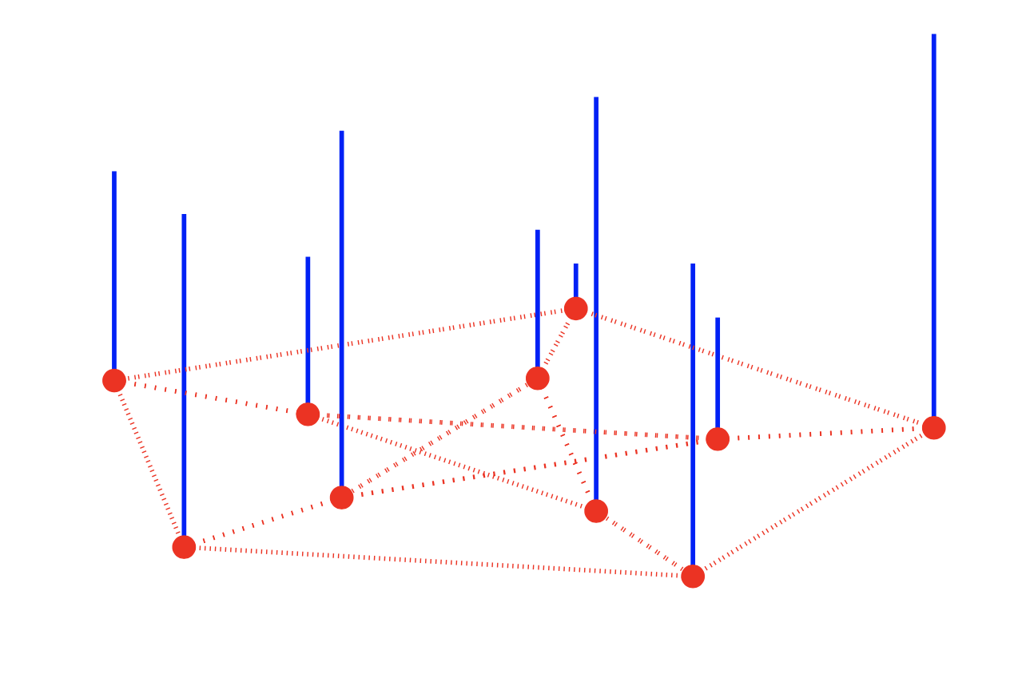
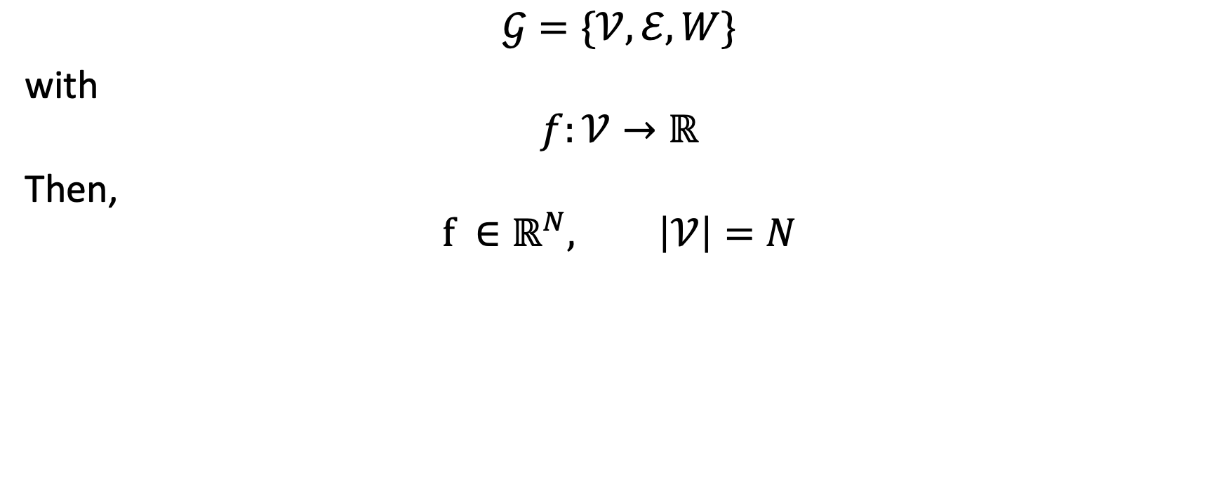
Graph Signals
$$𝒢=\{𝒱, ℰ,W\}$$
with
$$f:𝒱→ℝ$$
Then,
$$f {∈ℝ}^{N}, \left|𝒱\right|=N$$

Slide 9
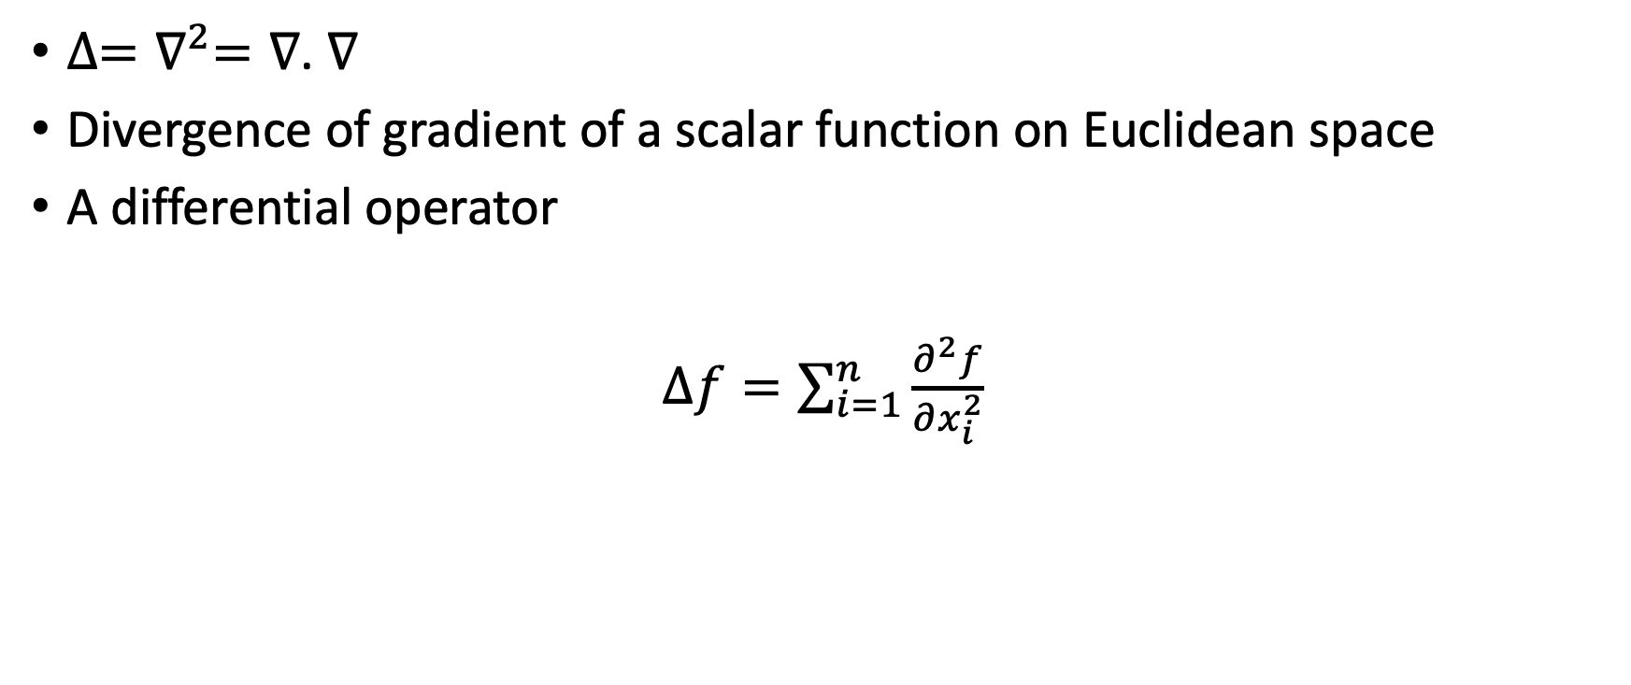
Laplacian Operator
$∆=∇^{2}=∇$. $∇$
Divergence of gradient of a scalar function on Euclidean space
A differential operator
$∆f=\sum_{i=1}^{n}{\frac{∂^{2}f}{∂x_{i}^{2}}}$

Slide 10
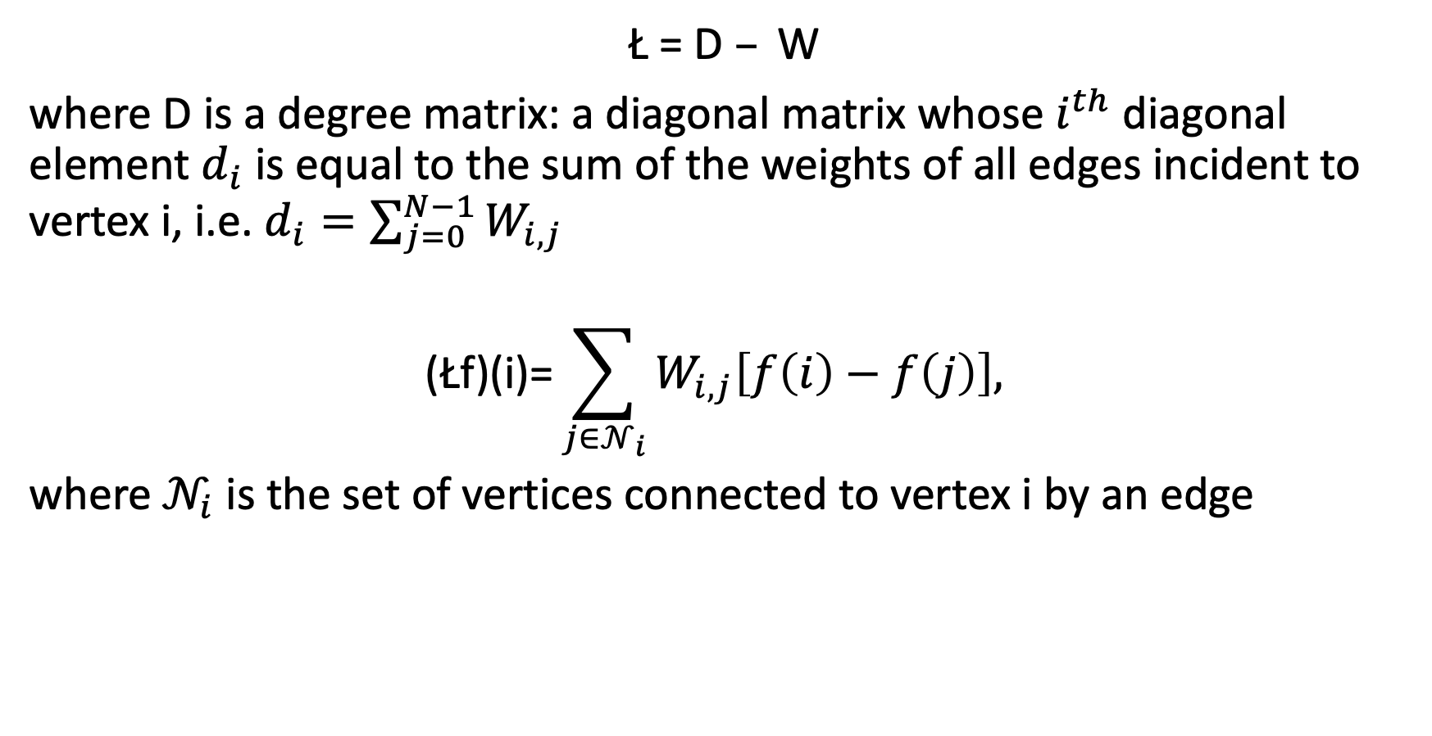
Non-normalized Graph Laplacian
$$\text{Ł}\text{ = }\text{D} – \text{W}$$
where D is a degree matrix: a diagonal matrix whose $i^{th}$ diagonal element $d_{i}$ is equal to the sum of the weights of all edges incident to vertex i, i.e. $d_{i}=\sum_{j=0}^{N−1}{W_{i,j}}$
$$\text{(}\text{Ł}\text{f}\text{)(}\text{i}\text{)=}\sum_{j∈𝒩_{i}}{W_{i,j}\left[f\left(i\right)−f\left(j\right)\right],}$$
where $𝒩_{i}$ is the set of vertices connected to vertex i by an edge

Slide 11
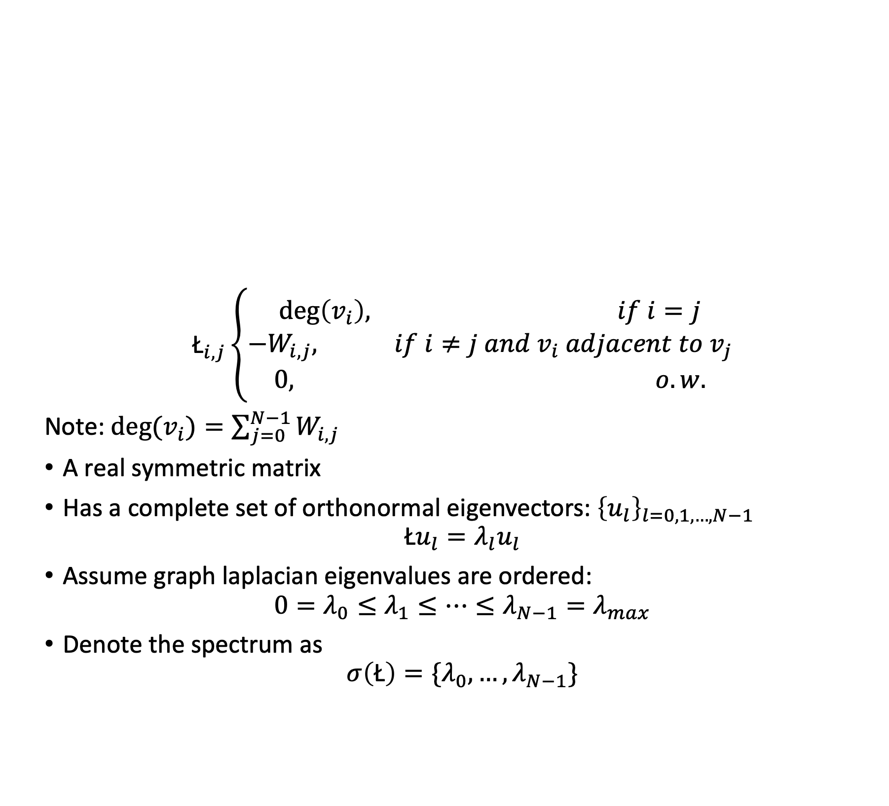
Non-normalized Graph Laplacian
$${\text{Ł}}_{i,j}\left\{\begin{aligned}\deg\left(v_{i}\right), if i=j \\ −W_{i,j}, if i≠j and v_{i} adjacent to v_{j} \\ 0, o.w.\end{aligned}\right.$$
Note: ${deg⁡(v}_{i})=\sum_{j=0}^{N−1}{W_{i,j}}$
A real symmetric matrix
Has a complete set of orthonormal eigenvectors: ${\left\{u_{l}\right\}}_{l=0,1,…,N−1}$
$${\text{Ł}u}_{l}={λ_{l}u}_{l}$$
Assume graph laplacian eigenvalues are ordered:
$${0=λ}_{0}≤λ_{1}≤…≤λ_{N−1}=λ_{max}$$
Denote the spectrum as
$$σ\left(\text{Ł}\right)=\{λ_{0},…,λ_{N−1}\}$$

Slide 12
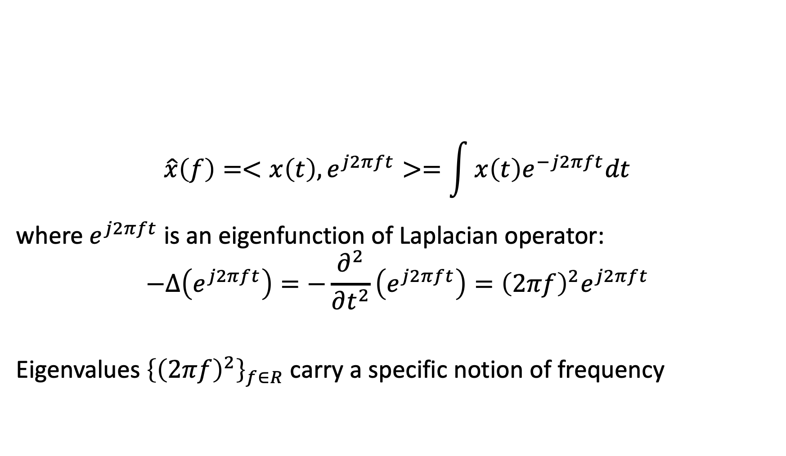
Fourier Transform
$$\hat{x}\left(f\right)=<x\left(t\right),e^{j2πft}>=\int{x\left(t\right)e^{−j2πft}dt}$$
where $e^{j2πft}$ is an eigenfunction of Laplacian operator:
$$−∆\left(e^{j2πft}\right)=−\frac{∂^{2}}{∂t^{2}}\left(e^{j2πft}\right)={\left(2πf\right)}^{2}e^{j2πft}$$
Eigenvalues ${\left\{{\left(2πf\right)}^{2}\right\}}_{f∈R}$ carry a specific notion of frequency

Slide 13
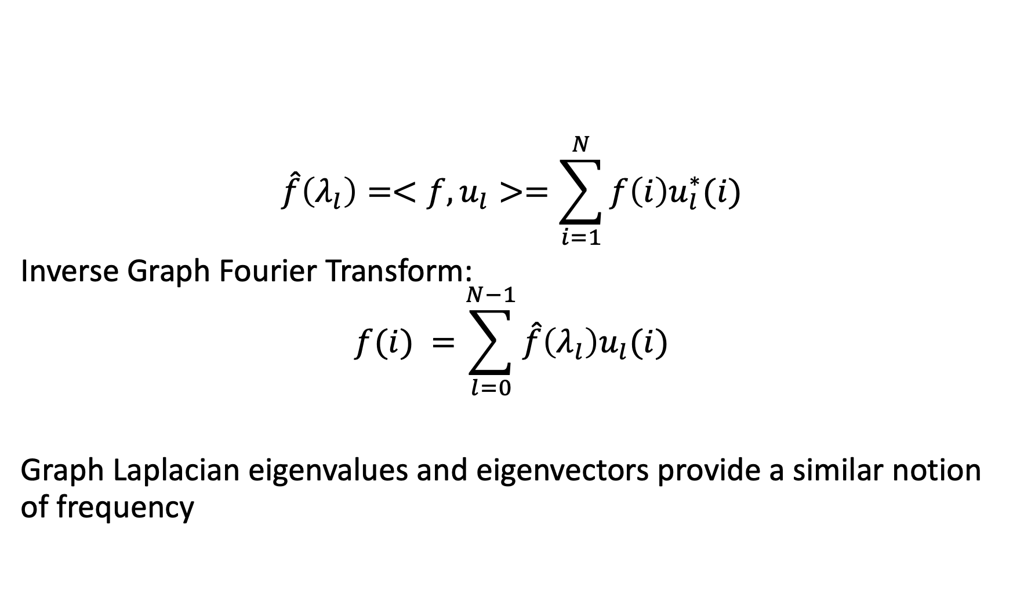
Graph Fourier Transform
$$\hat{f}\left(λ_{l}\right)=<f,u_{l}>=\sum_{i=1}^{N}{f\left(i\right)u_{l}^{∗}(i)}$$
Inverse Graph Fourier Transform:
$$f(i) =\sum_{l=0}^{N−1}{\hat{f}\left(λ_{l}\right)u_{l}(i)}$$
Graph Laplacian eigenvalues and eigenvectors provide a similar notion of frequency

Slide 14
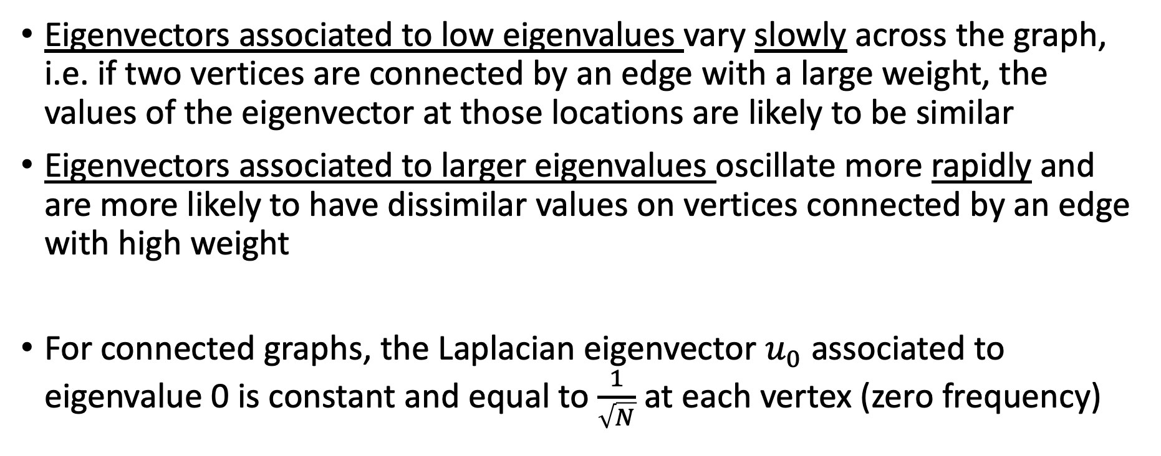
Frequency Notion at Graph Fourier Transform
Eigenvectors associated to low eigenvalues vary slowly across the graph, i.e. if two vertices are connected by an edge with a large weight, the values of the eigenvector at those locations are likely to be similar
Eigenvectors associated to larger eigenvalues oscillate more rapidly and are more likely to have dissimilar values on vertices connected by an edge with high weight
For connected graphs, the Laplacian eigenvector $u_{0}$ associated to eigenvalue 0 is constant and equal to $\frac{1}{\sqrt{N}}$ at each vertex (zero frequency)

Slide 15
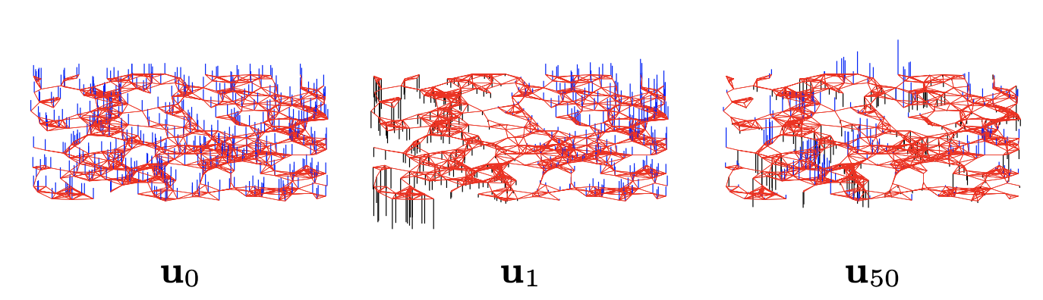
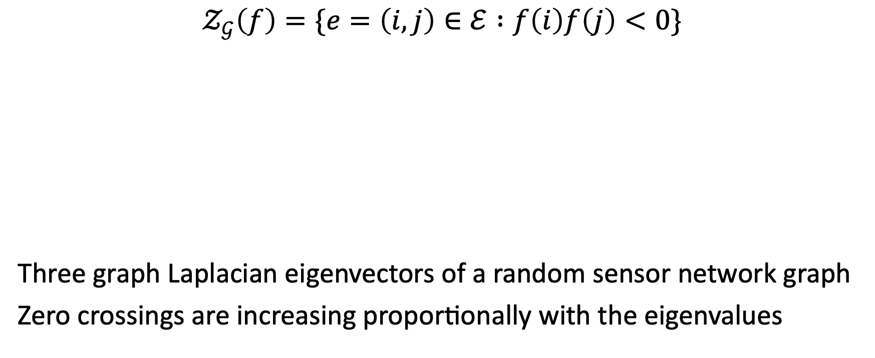
Zero Crossings of a Graph
$$𝒵_{𝒢}\left(f\right)=\{e=\left(i,j\right)∈ℰ :f\left(i\right)f\left(j\right)<0\}$$
Three graph Laplacian eigenvectors of a random sensor network graph
Zero crossings are increasing proportionally with the eigenvalues

Slide 16
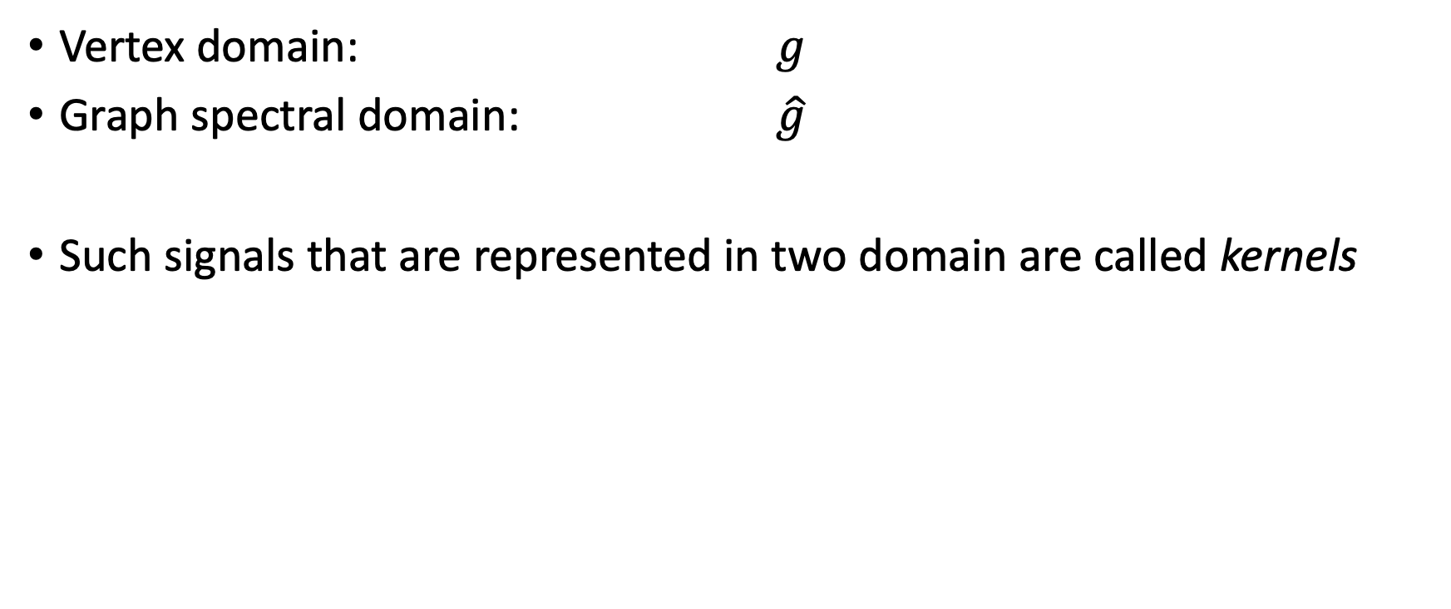
Graph Signal Representations in Two Domains
Vertex domain: $g$
Graph spectral domain: $\hat{g}$
Such signals that are represented in two domain are called kernels

Slide 17
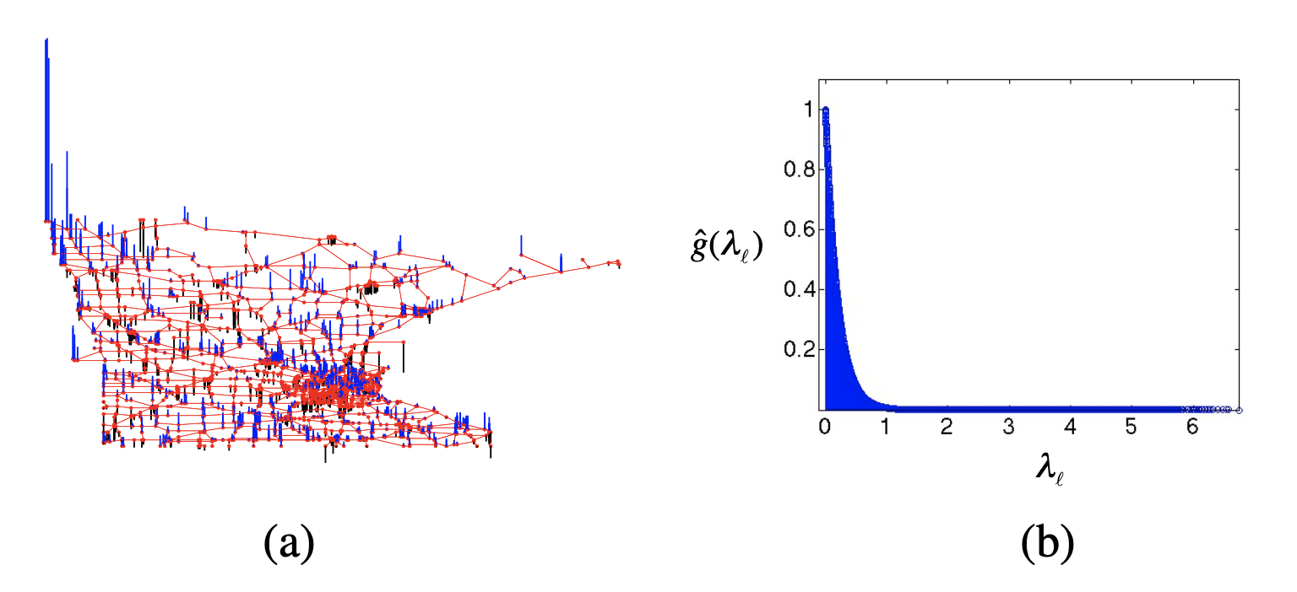
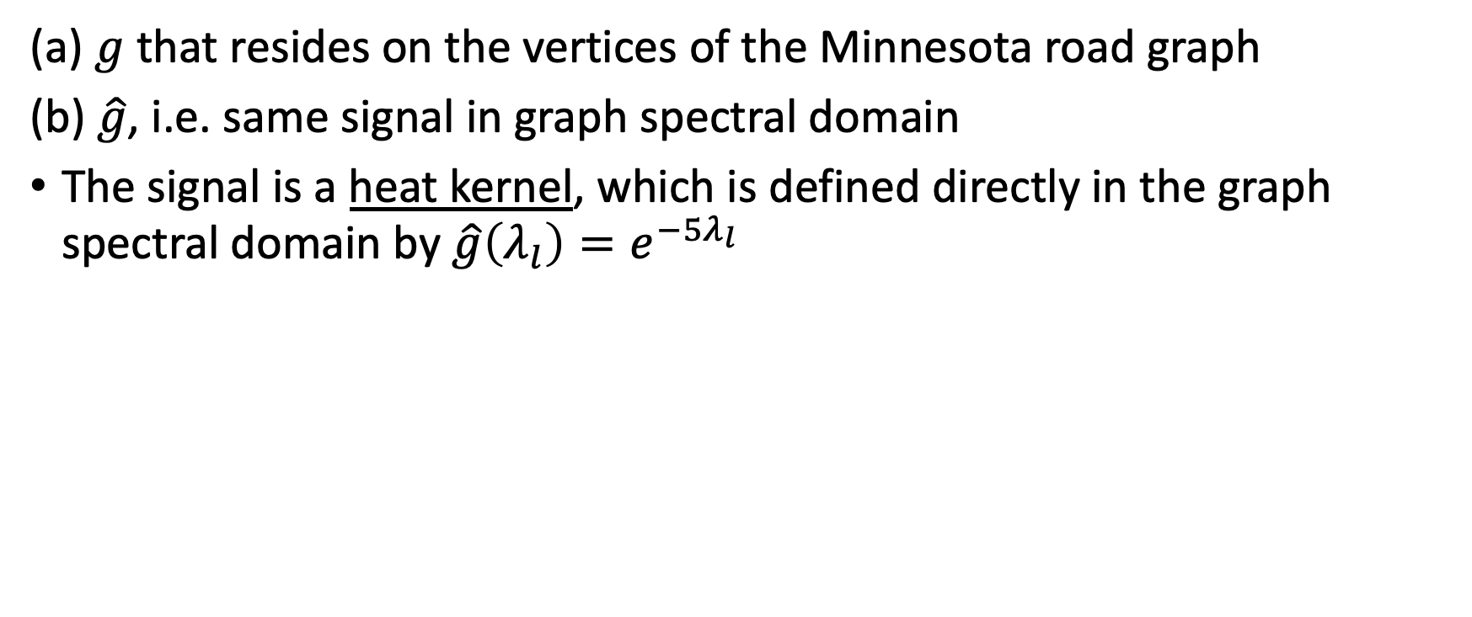
Heat Kernel
(a) $g$ that resides on the vertices of the Minnesota road graph
(b) $\hat{g}$, i.e. same signal in graph spectral domain
The signal is a heat kernel, which is defined directly in the graph spectral domain by $\hat{g}\left(λ_{l}\right)=e^{−5λ_{l}}$
Observation: Graph Fourier coefficients of a smooth signal decay rapidly like in the cases of classical signal processing
* Such signals are compressible

Slide 18
Discrete Calculus and Signal Smoothness
Smoothness are wrt the intrinsic structure of the data domain – weighted graph
Differential Geometry:
incorporates geometric structure of underlying manifold into the analysis of continuous signals on differentiable manifolds
Discrete Calculus:
provides a set of definitions and differential operators that make it possible to operate the machinery of multivariate calculus on a finite, discrete space

Slide 19
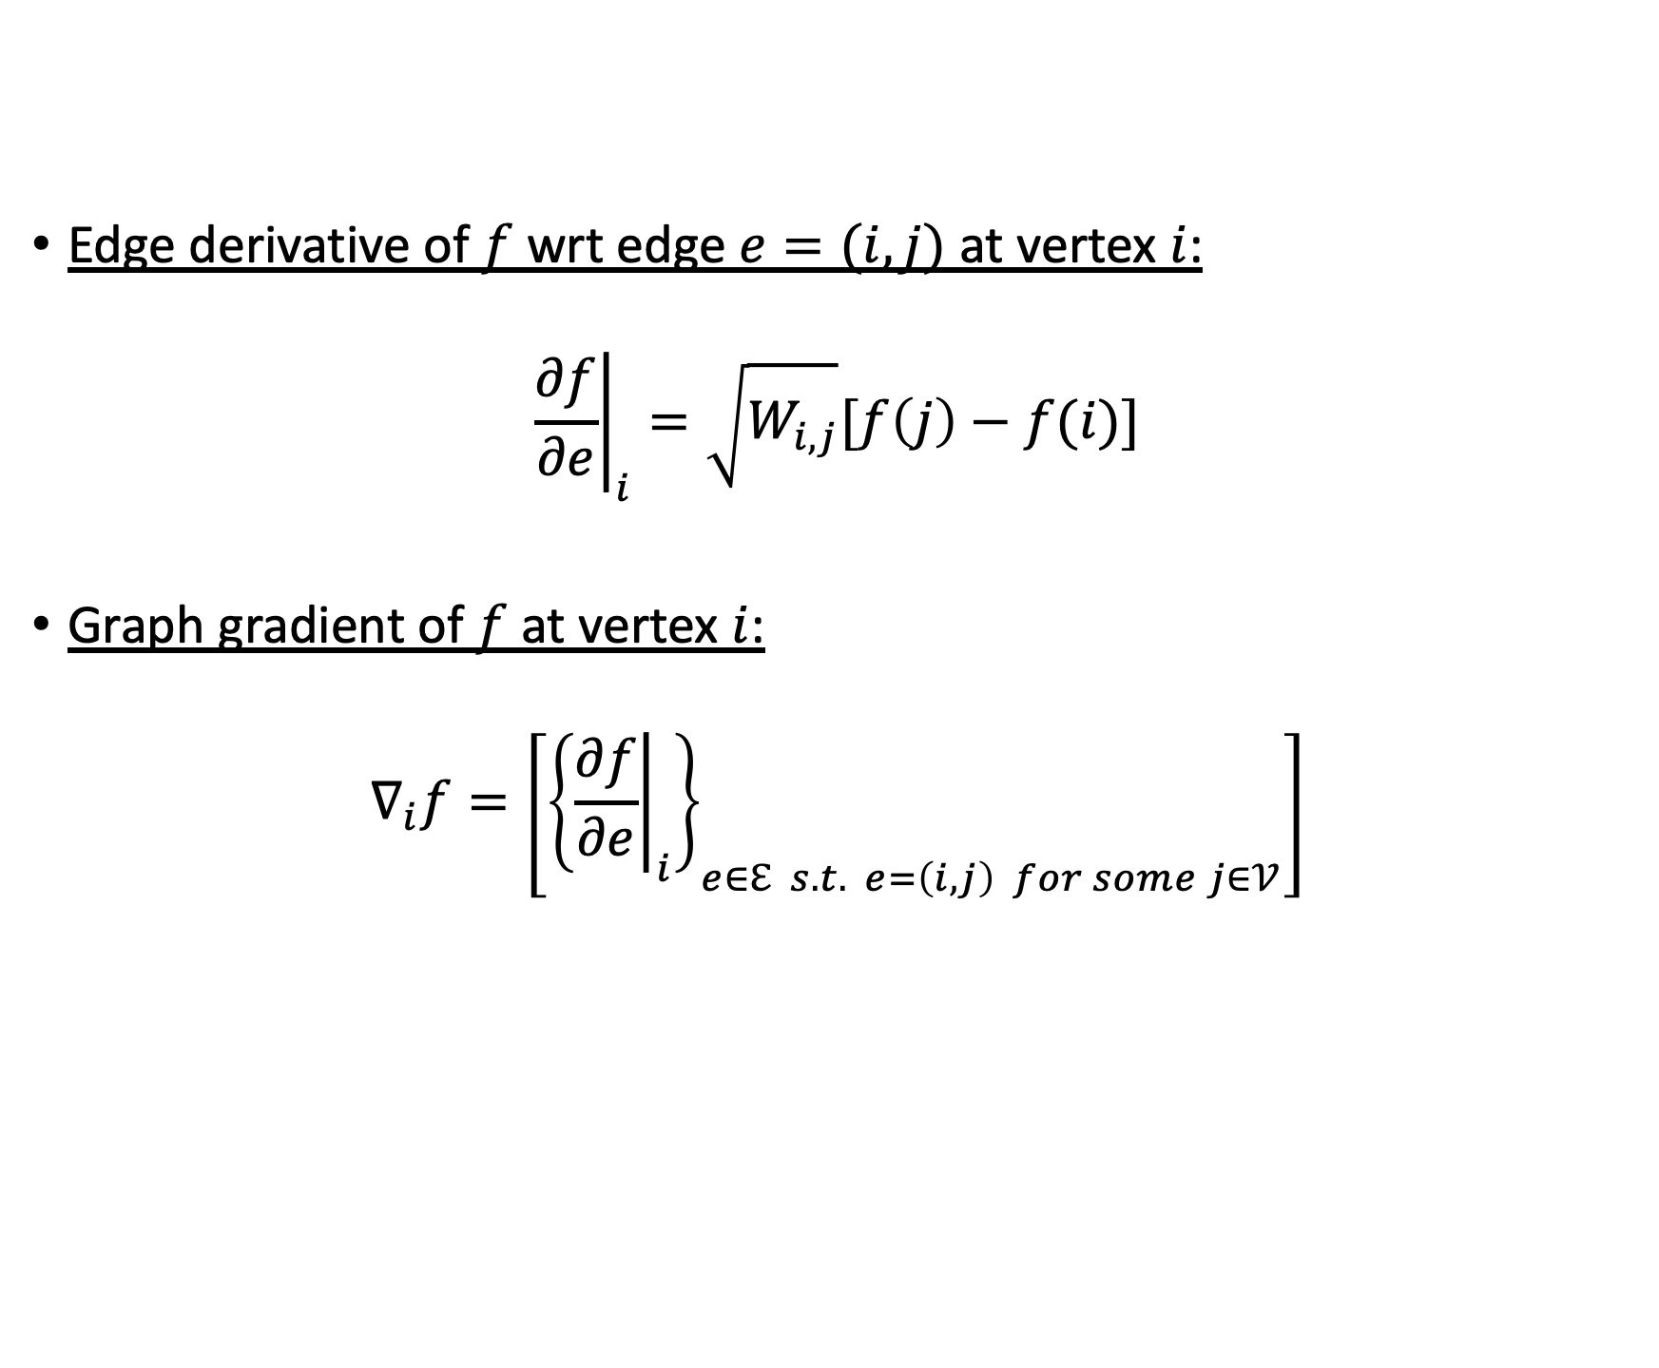
Signal Smoothness wrt Intrinsic Structure of Graph
Edge derivative of $f$ wrt edge $e=(i,j)$ at vertex $i$:
$${\left.\frac{∂f}{∂e}\right|}_{i}=\sqrt{W_{i,j}}[f\left(j\right)−f(i)]$$
Graph gradient of $f$ at vertex $i$:
$$∇_{i}f=\left[{\left\{{\left.\frac{∂f}{∂e}\right|}_{i}\right\}}_{e∈ℇ s.t. e=\left(i,j\right) for some j∈𝒱}\right]$$

Slide 20
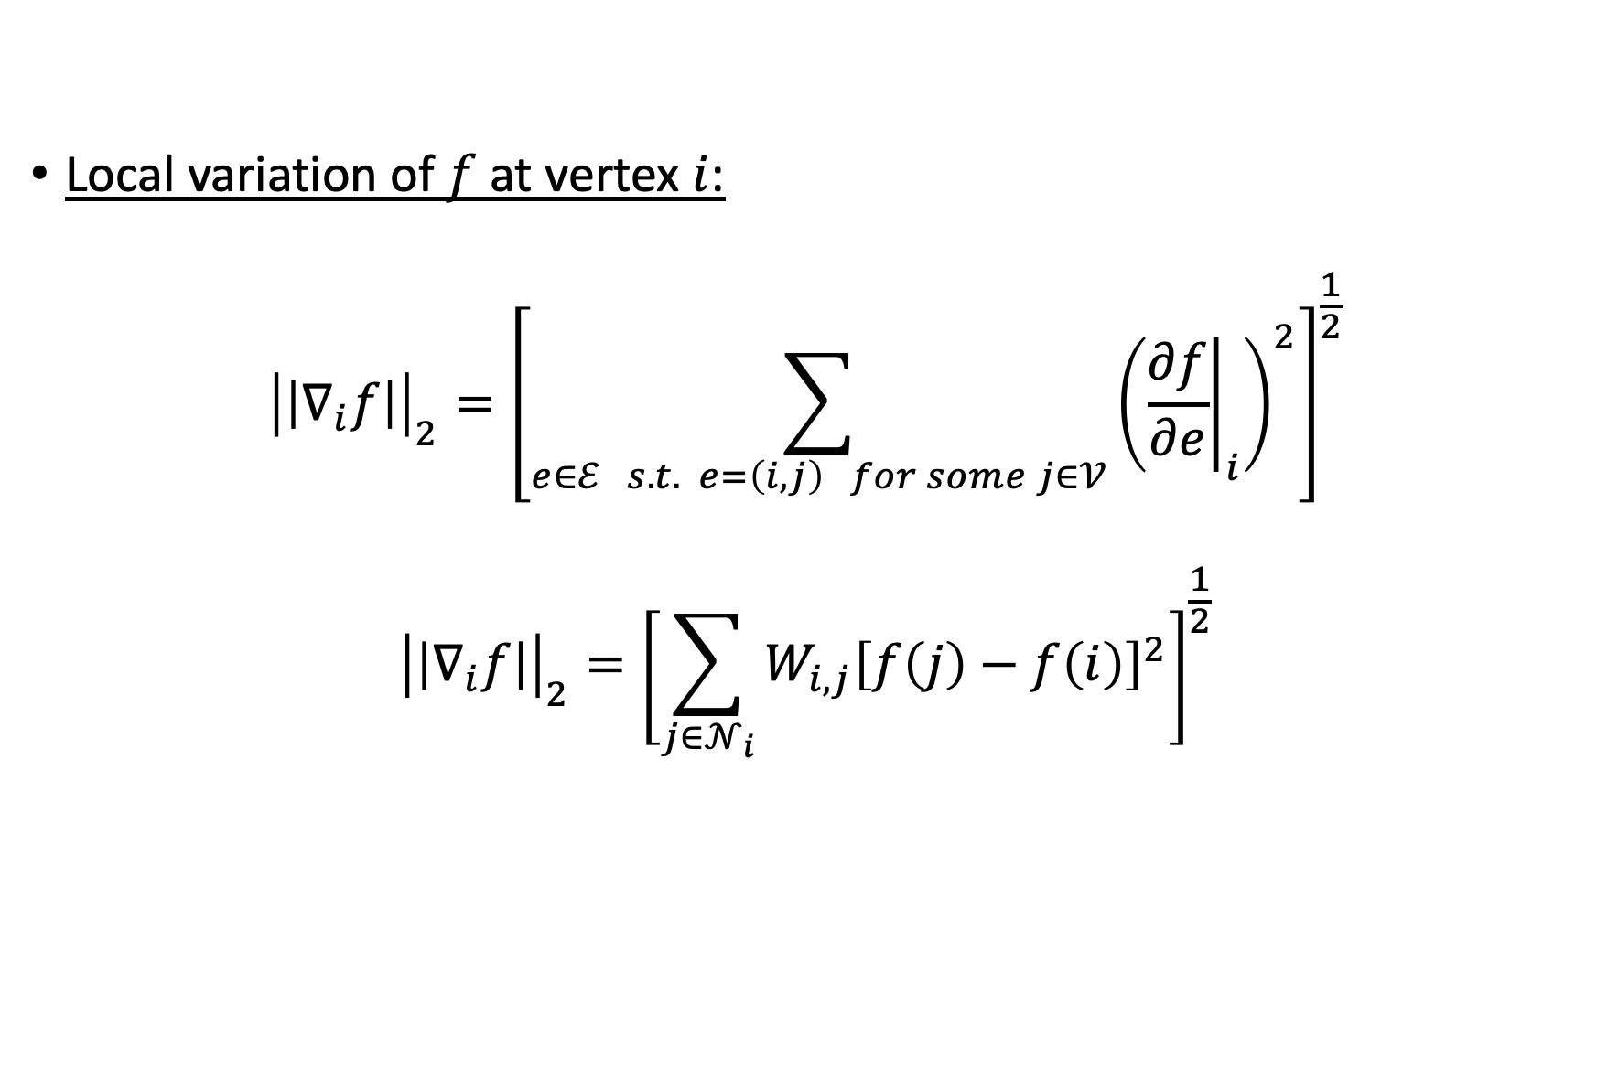
Signal Smoothness wrt Intrinsic Structure of Graph
Local variation of $f$ at vertex $i$:
$${\left|\left|∇_{i}f\right|\right|}_{2}={\left[\sum_{e∈ℰ s.t. e=\left(i,j\right) for some j∈𝒱}{{\left({\left.\frac{∂f}{∂e}\right|}_{i}\right)}^{2}}\right]}^{\frac{1}{2}}$$
$${\left|\left|∇_{i}f\right|\right|}_{2}={\left[\sum_{j∈𝒩_{i}}{W_{i,j}{\left[f\left(j\right)−f\left(i\right)\right]}^{2}}\right]}^{\frac{1}{2}}$$

Slide 21
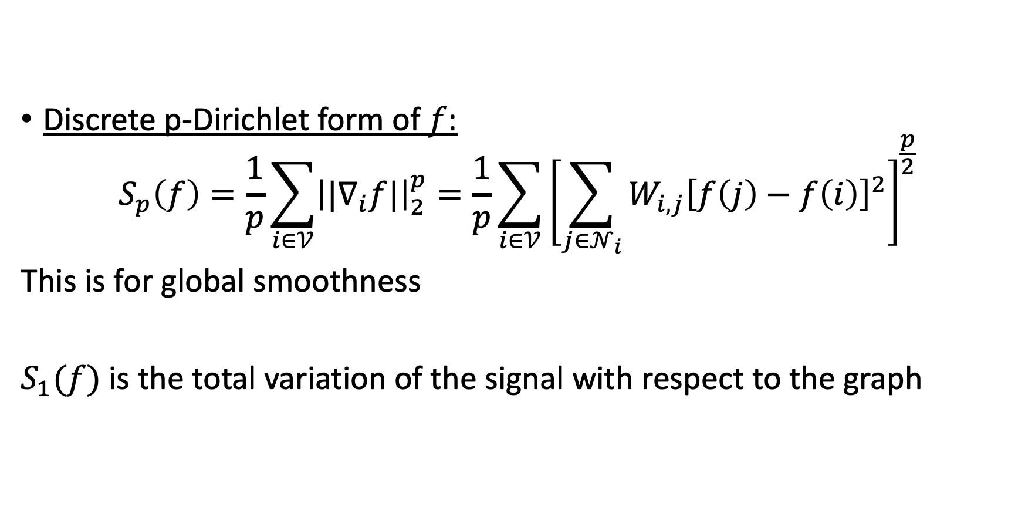
Signal Smoothness wrt Intrinsic Structure of Graph
Discrete p-Dirichlet form of $f$:
$$S_{p}\left(f\right)=\frac{1}{p}\sum_{i∈𝒱}{{\left||∇_{i}f|\right|}_{2}^{p}}=\frac{1}{p}\sum_{i∈𝒱}{{\left[\sum_{j∈𝒩_{i}}{W_{i,j}{\left[f\left(j\right)−f\left(i\right)\right]}^{2}}\right]}^{\frac{p}{2}}}$$
This is for global smoothness
$S_{1}(f)$ is the total variation of the signal with respect to the graph

Slide 22
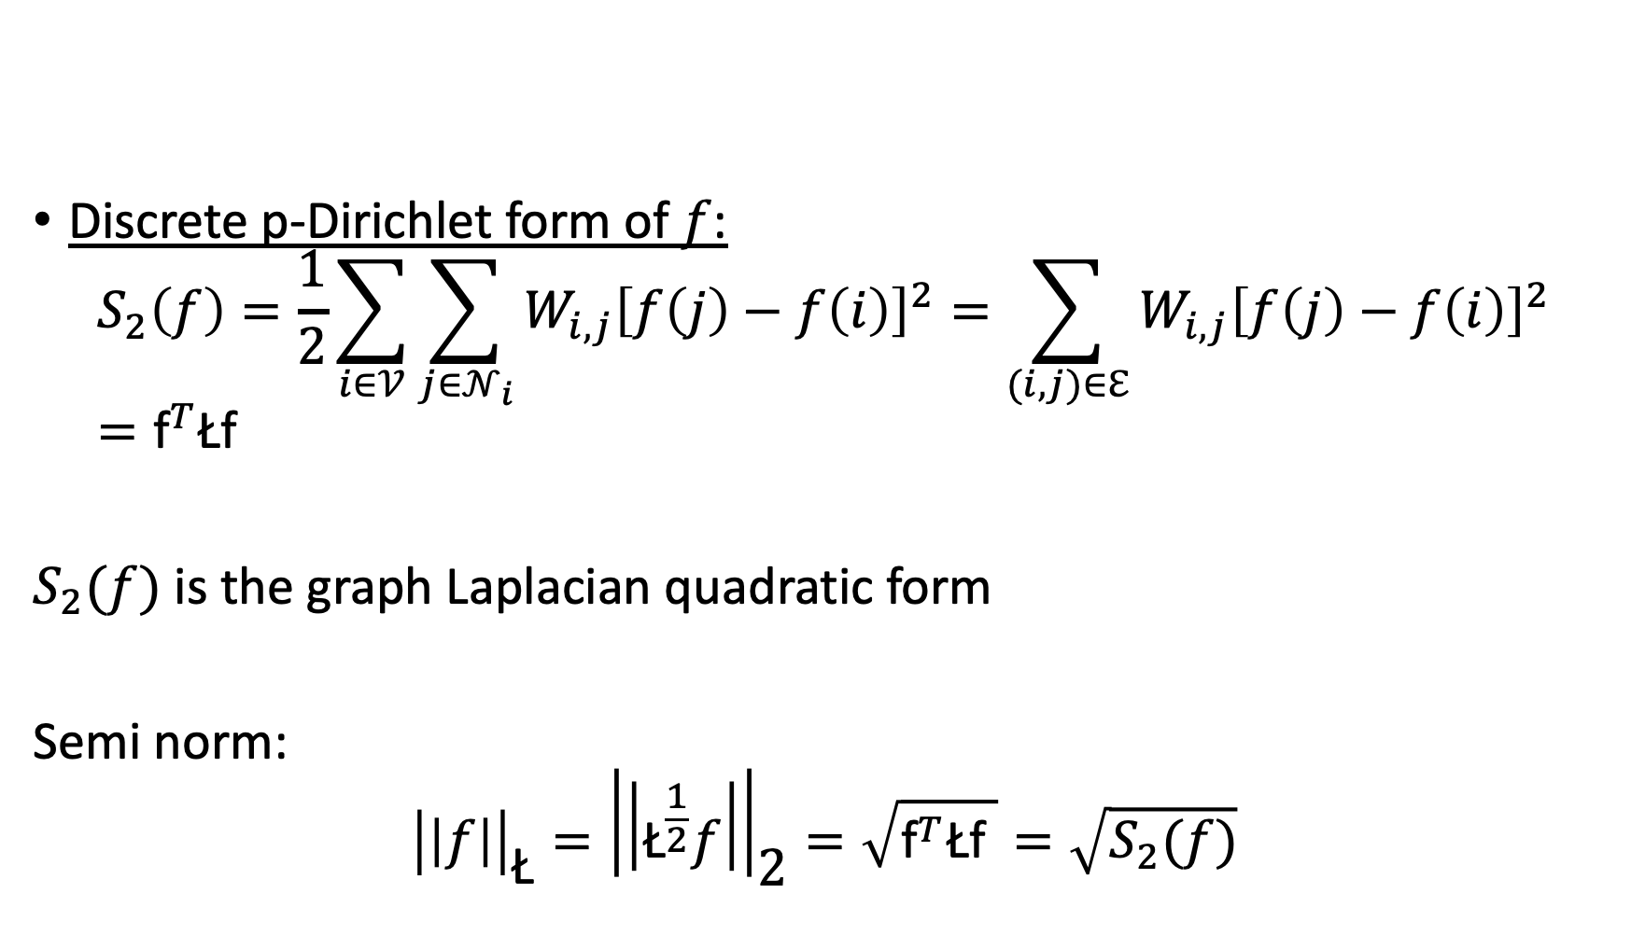
Signal Smoothness wrt Intrinsic Structure of Graph
Discrete p-Dirichlet form of $f$:
$$S_{2}\left(f\right)=\frac{1}{2}\sum_{i∈𝒱}{\sum_{j∈𝒩_{i}}{W_{i,j}{\left[f\left(j\right)−f\left(i\right)\right]}^{2}}}=\sum_{(i,j)∈ℇ}{W_{i,j}{\left[f\left(j\right)−f\left(i\right)\right]}^{2}}={\text{f}}^{T}\text{Ł}\text{f}$$
$S_{2}(f)$ is the graph Laplacian quadratic form
Semi norm:
$${\left|\left|f\right|\right|}_{\text{Ł}}={\left|\left|{\text{Ł}}^{\frac{1}{2}}f\right|\right|}_{\text{2}}=\sqrt{{\text{f}}^{T}\text{Ł}\text{f} }=\sqrt{S_{2}(f)}$$

Slide 23
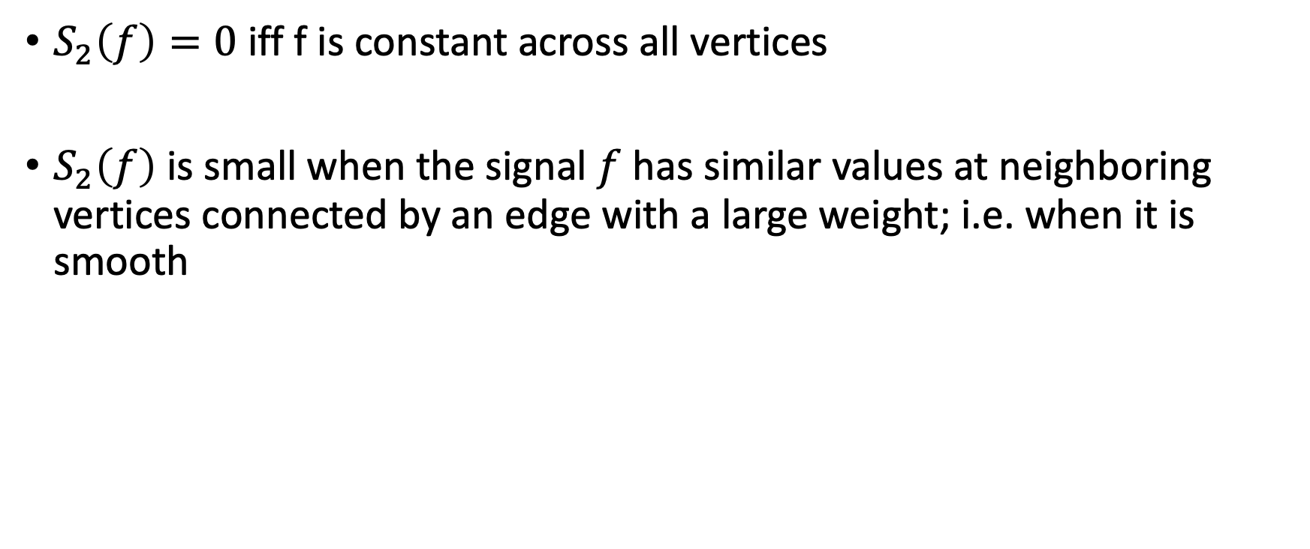
Signal Smoothness wrt Intrinsic Structure of Graph
$S_{2}\left(f\right)=0$ iff f is constant across all vertices
$S_{2}\left(f\right)$ is small when the signal $f$ has similar values at neighboring vertices connected by an edge with a large weight; i.e. when it is smooth

Slide 24
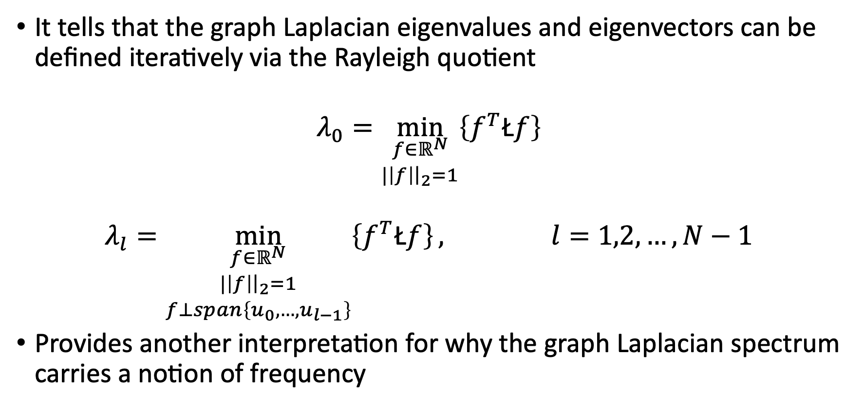
Courant-Fisher Theorem
It tells that the graph Laplacian eigenvalues and eigenvectors can be defined iteratively via the Rayleigh quotient
$$λ_{0}=\min_{\begin{matrix}f∈ℝ^{N} \\ |\left|f\right|{\left.​\right|}_{2}=1\end{matrix}}\left\{f^{T}\text{Ł}f\right\}$$
$$λ_{l}=\min_{\begin{matrix}f∈ℝ^{N} \\ |\left|f\right|{\left.​\right|}_{2}=1 \\ f⊥span\left\{u_{0},…,u_{l−1}\right\}\end{matrix}}\left\{f^{T}\text{Ł}f\right\}, l=1,2,…,N−1$$
Provides another interpretation for why the graph Laplacian spectrum carries a notion of frequency

Slide 25
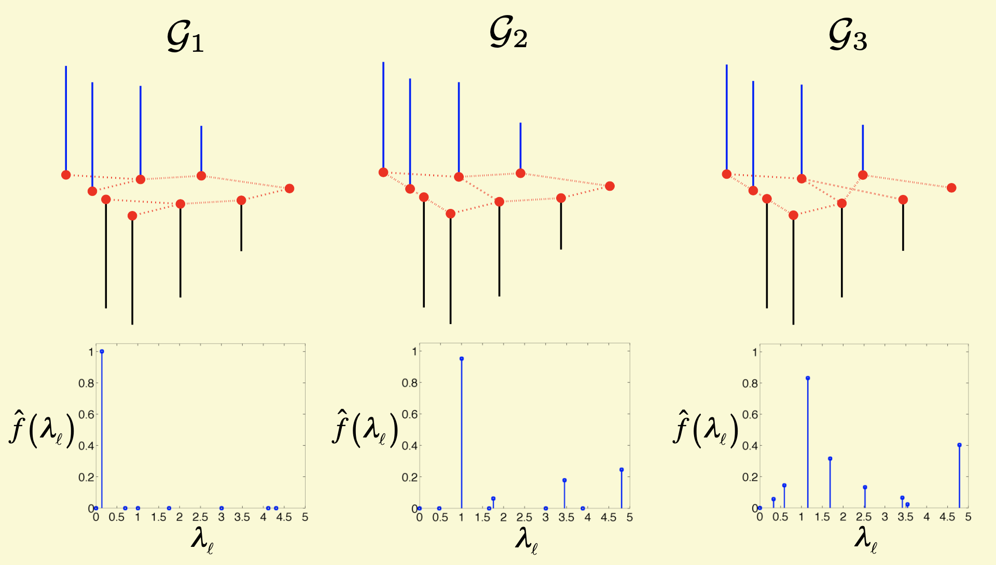
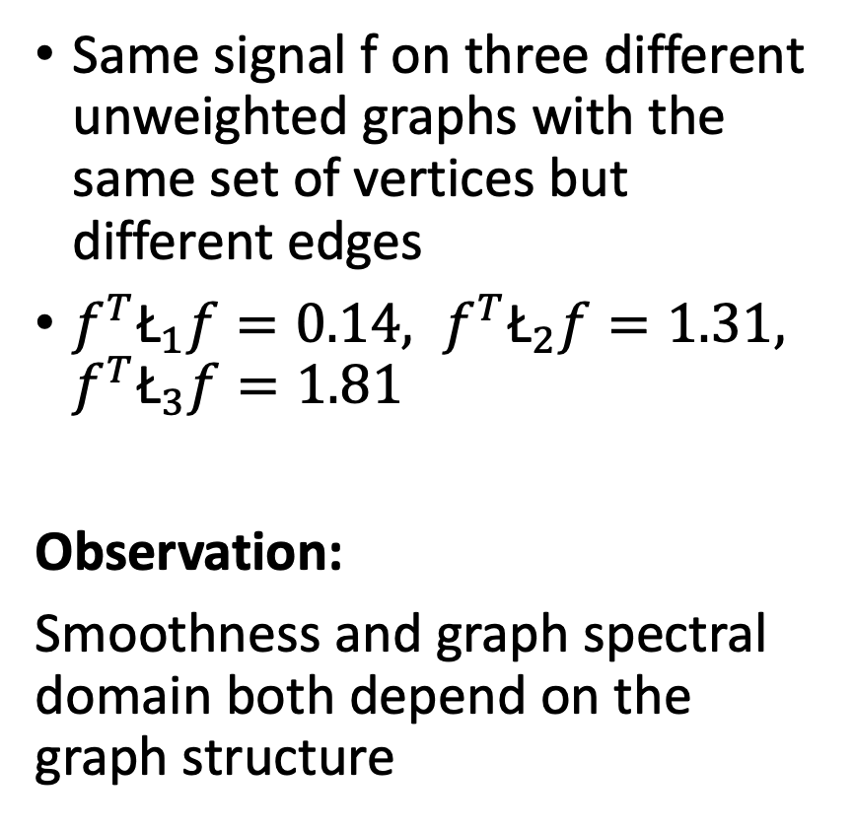
Example on smoothness and spectral of graph signals
Same signal f on three different unweighted graphs with the same set of vertices but different edges
$f^{T}{\text{Ł}}_{1}f=0.14, f^{T}{\text{Ł}}_{2}f=1.31,$ $f^{T}{\text{Ł}}_{3}f=1.81$
Observation:
Smoothness and graph spectral domain both depend on the graph structure

Slide 26
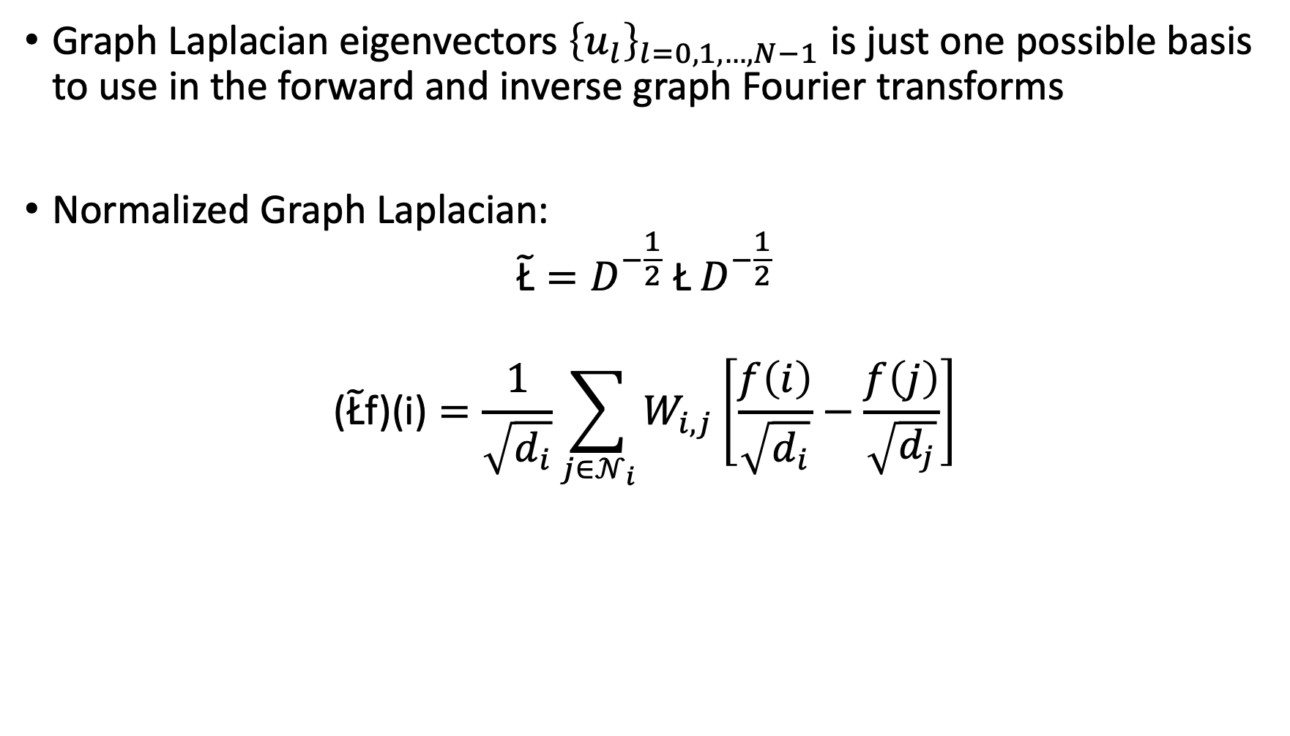
Other Graph Matrices
Graph Laplacian eigenvectors ${\left\{u_{l}\right\}}_{l=0,1,…,N−1}$ is just one possible basis to use in the forward and inverse graph Fourier transforms
Normalized Graph Laplacian:
$${\tilde{\text{Ł}}=D}^{−\frac{1}{2}} \text{Ł} D^{−\frac{1}{2}}$$
$$\text{(}\tilde{\text{Ł}}\text{f}\text{)(}\text{i}\text{)}=\frac{1}{\sqrt{d_{i}}}\sum_{j∈𝒩_{i}}{W_{i,j}\left[\frac{f\left(i\right)}{\sqrt{d_{i}}}−\frac{f\left(j\right)}{\sqrt{d_{j}}}\right]}$$

Slide 27
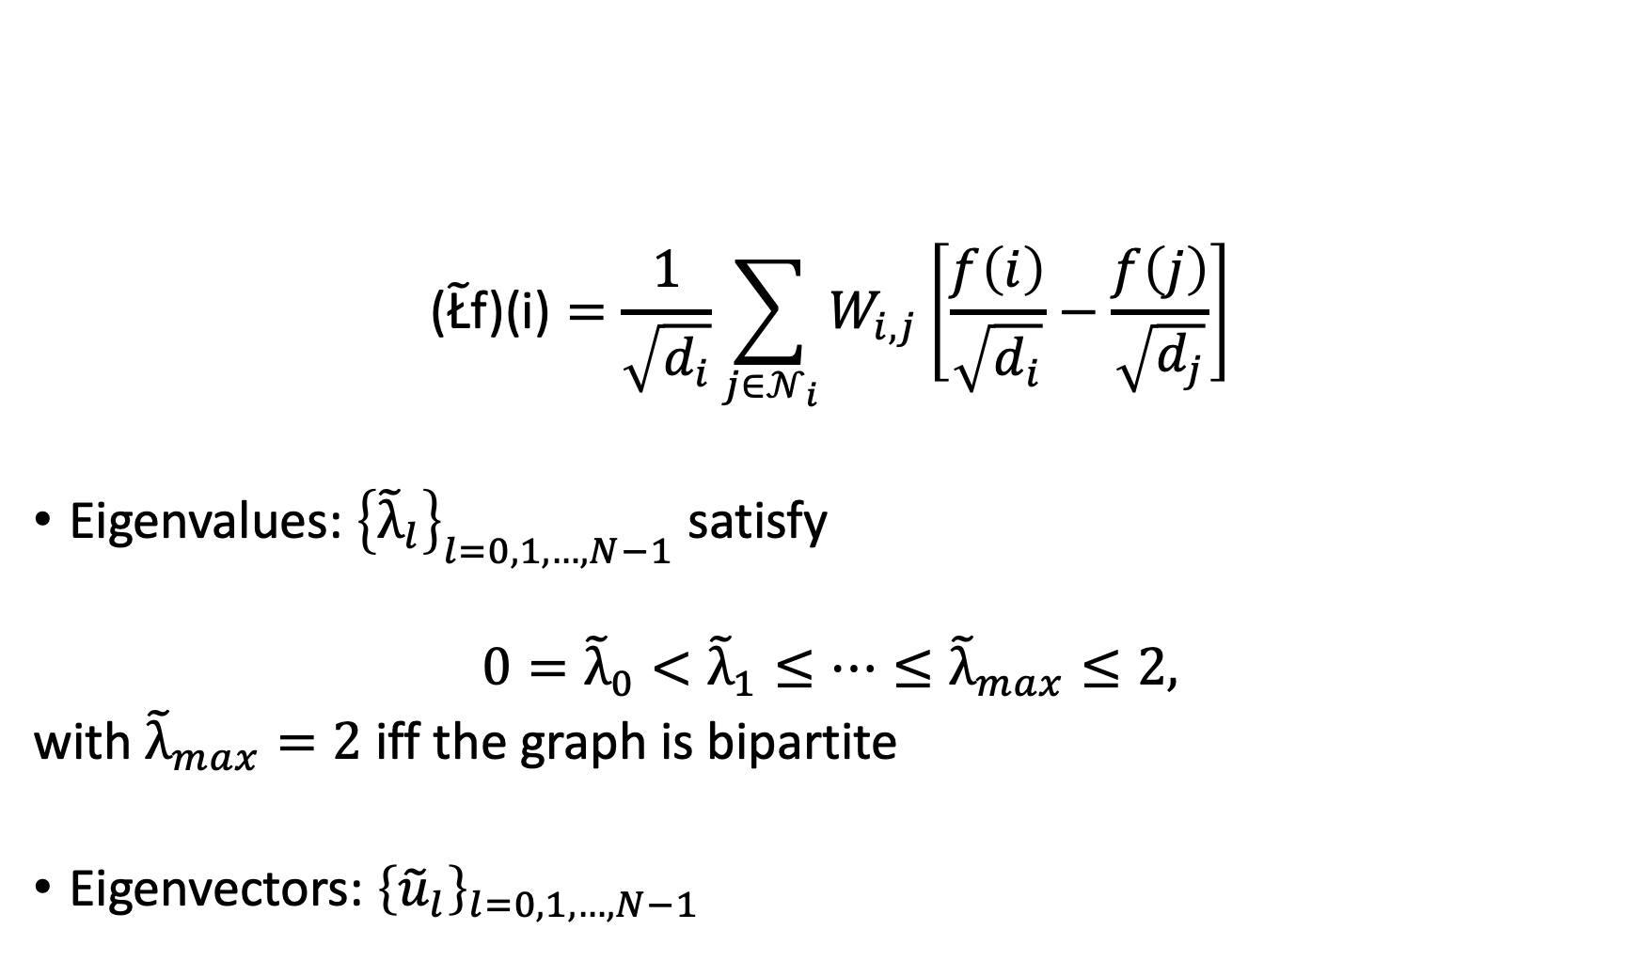
Normalized Graph Laplacian
$$\text{(}\tilde{\text{Ł}}\text{f}\text{)(}\text{i}\text{)}=\frac{1}{\sqrt{d_{i}}}\sum_{j∈𝒩_{i}}{W_{i,j}\left[\frac{f\left(i\right)}{\sqrt{d_{i}}}−\frac{f\left(j\right)}{\sqrt{d_{j}}}\right]}$$
Eigenvalues: ${\left\{{\tilde{λ}}_{l}\right\}}_{l=0,1,…,N−1}$ satisfy
$${0=\tilde{λ}}_{0}<{\tilde{λ}}_{1}≤…≤{\tilde{λ}}_{max}≤2,$$
with ${\tilde{λ}}_{max}=2$ iff the graph is bipartite
Eigenvectors: ${\left\{{\tilde{u}}_{l}\right\}}_{l=0,1,…,N−1}$

Slide 28
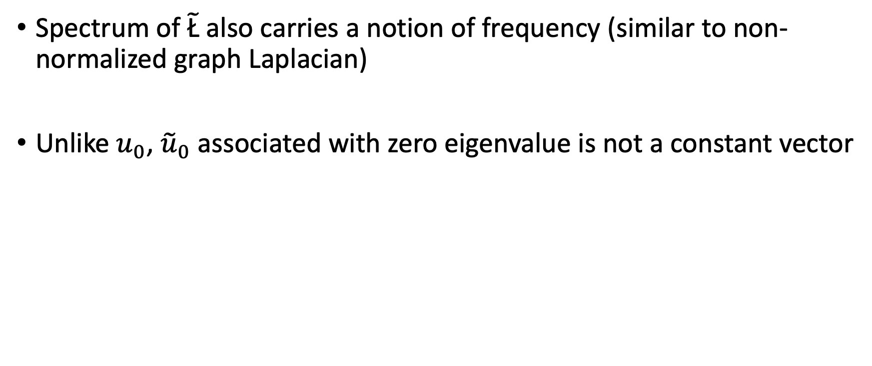
Normalized Graph Laplacian
Spectrum of $\tilde{\text{Ł}}$ also carries a notion of frequency (similar to non-normalized graph Laplacian)
Unlike $u_{0}$, ${\tilde{u}}_{0}$ associated with zero eigenvalue is not a constant vector

Slide 29
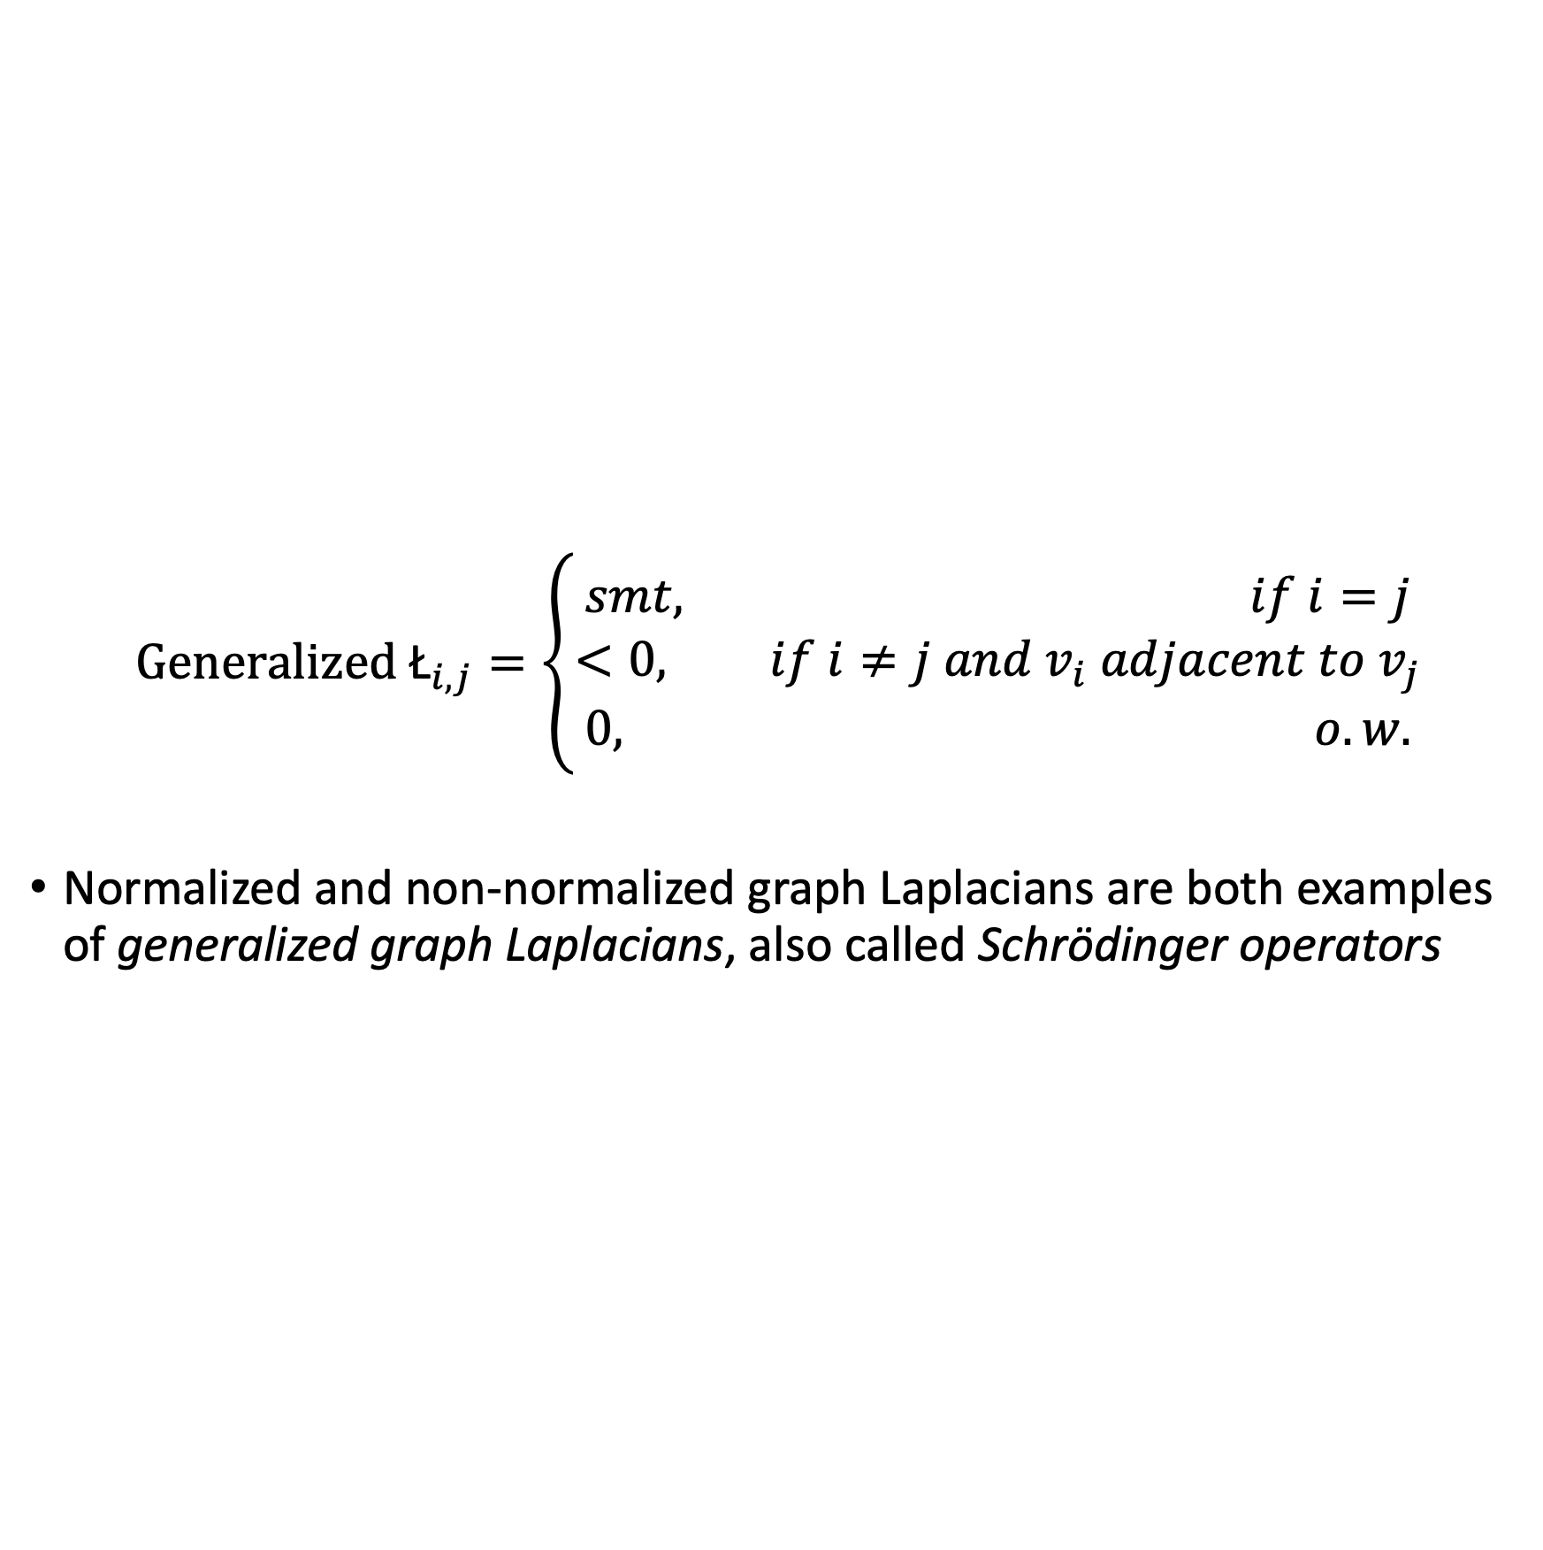
Generalized Graph Laplacians
$${\text{Generalized} \text{Ł}}_{i,j}=\left\{\begin{aligned}smt, if i=j \\ <0, if i≠j and v_{i} adjacent to v_{j} \\ 0, o.w.\end{aligned}\right.$$
Normalized and non-normalized graph Laplacians are both examples of generalized graph Laplacians, also called Schrödinger operators

Slide 30
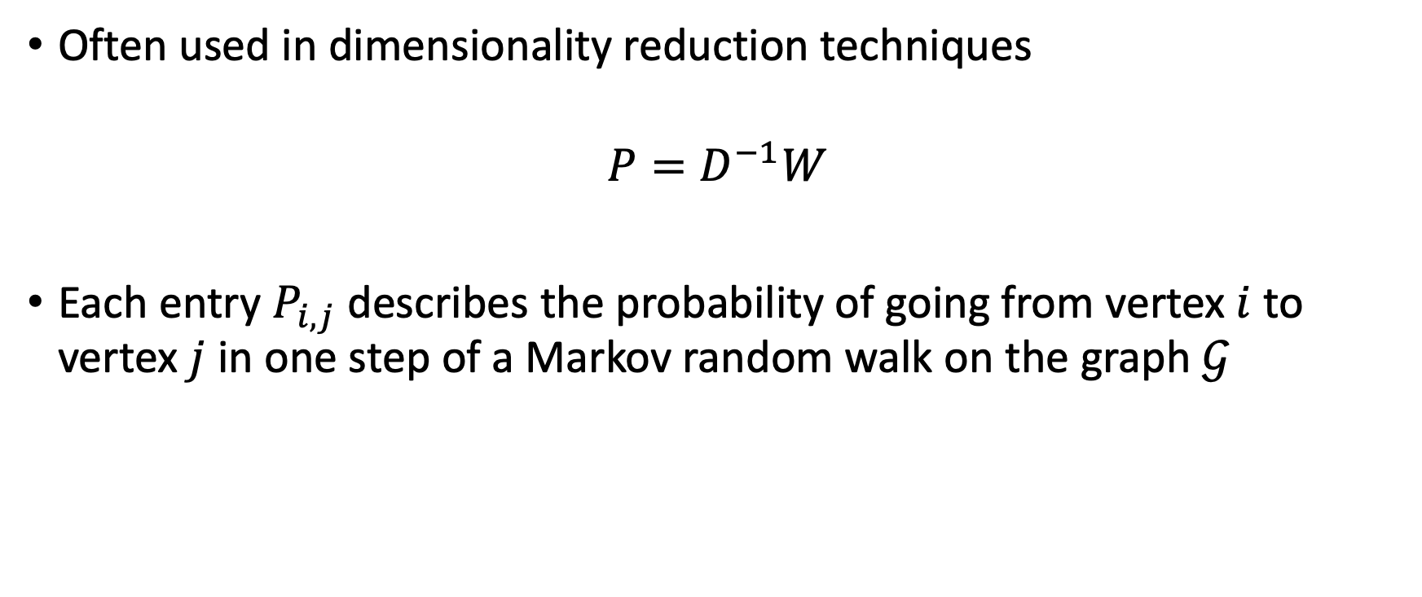
Random Walk Matrix
Often used in dimensionality reduction techniques
$$P=D^{−1}W$$
Each entry $P_{i,j}$ describes the probability of going from vertex $i$ to vertex $j$ in one step of a Markov random walk on the graph $𝒢$

Slide 31
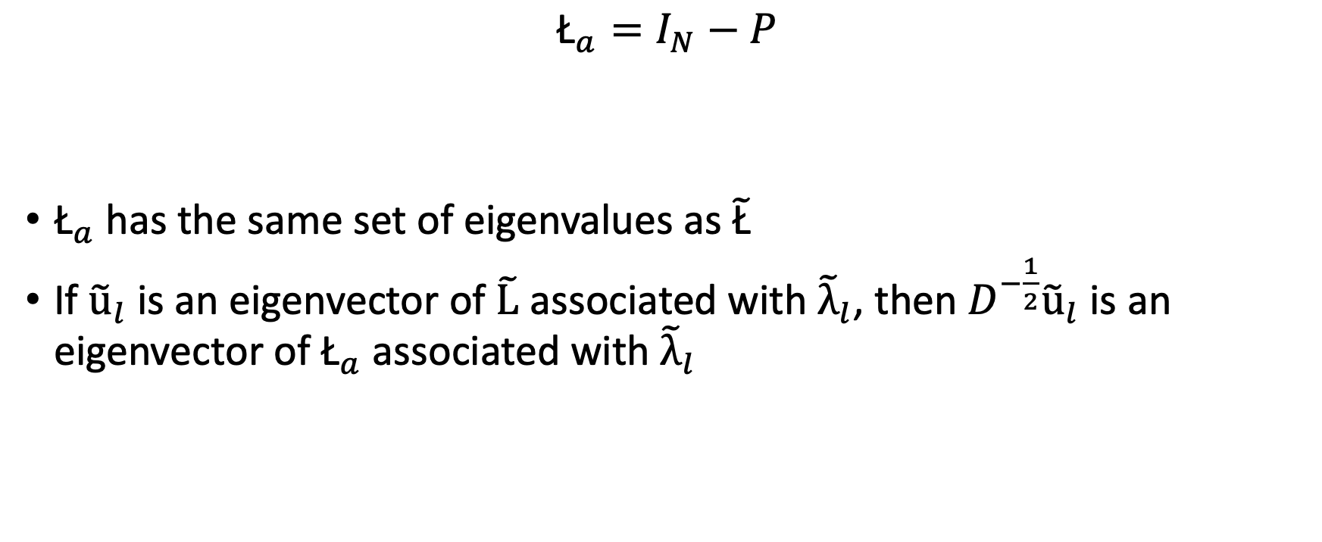
Asymmetric Graph Laplacian
$${\text{Ł}}_{a}=I_{N}−P$$
${\text{Ł}}_{a}$ has the same set of eigenvalues as $\tilde{\text{Ł}}$
If ${\tilde{\text{u}}}_{l}$ is an eigenvector of $\tilde{\text{L}}$ associated with ${\tilde{λ}}_{l}$, then $D^{−\frac{1}{2}}{\tilde{\text{u}}}_{l}$ is an eigenvector of ${\text{Ł}}_{a}$ associated with ${\tilde{λ}}_{l}$

Slide 32
Generalized Operators for Signals on Graphs
Filtering
Convolution
Translation
Modulation and Dilation
Graph Coarsening, Downsampling and Reduction

Slide 33
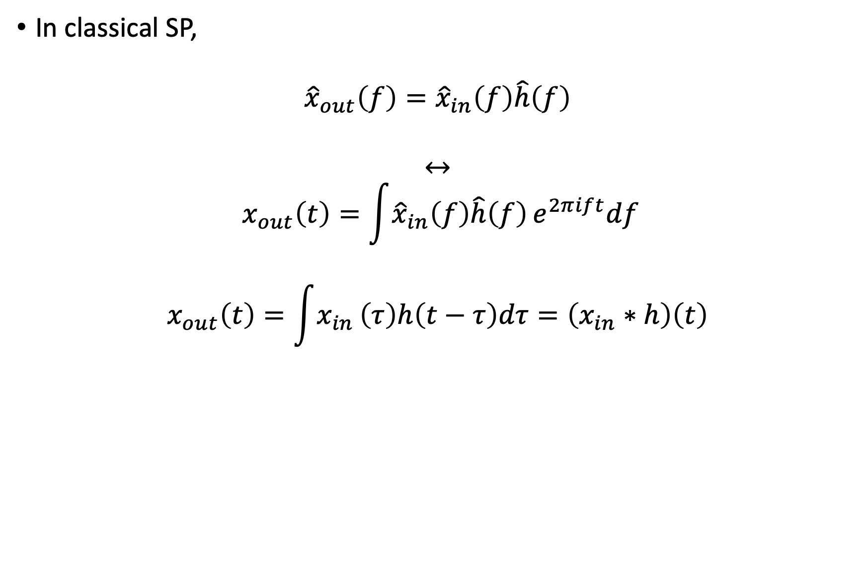
Frequency Filtering
In classical SP,
$${\hat{x}}_{out}\left(f\right)={\hat{x}}_{in}\left(f\right)\hat{h}\left(f\right)$$
$$↔$$
$$x_{out}\left(t\right)=\int{{\hat{x}}_{in}\left(f\right)\hat{h}\left(f\right)}e^{2πift}df$$
$$x_{out}\left(t\right)=\int{x_{in}}\left(τ\right)h\left(t−τ\right)dτ=\left(x_{in}∗h\right)\left(t\right)$$

Slide 34
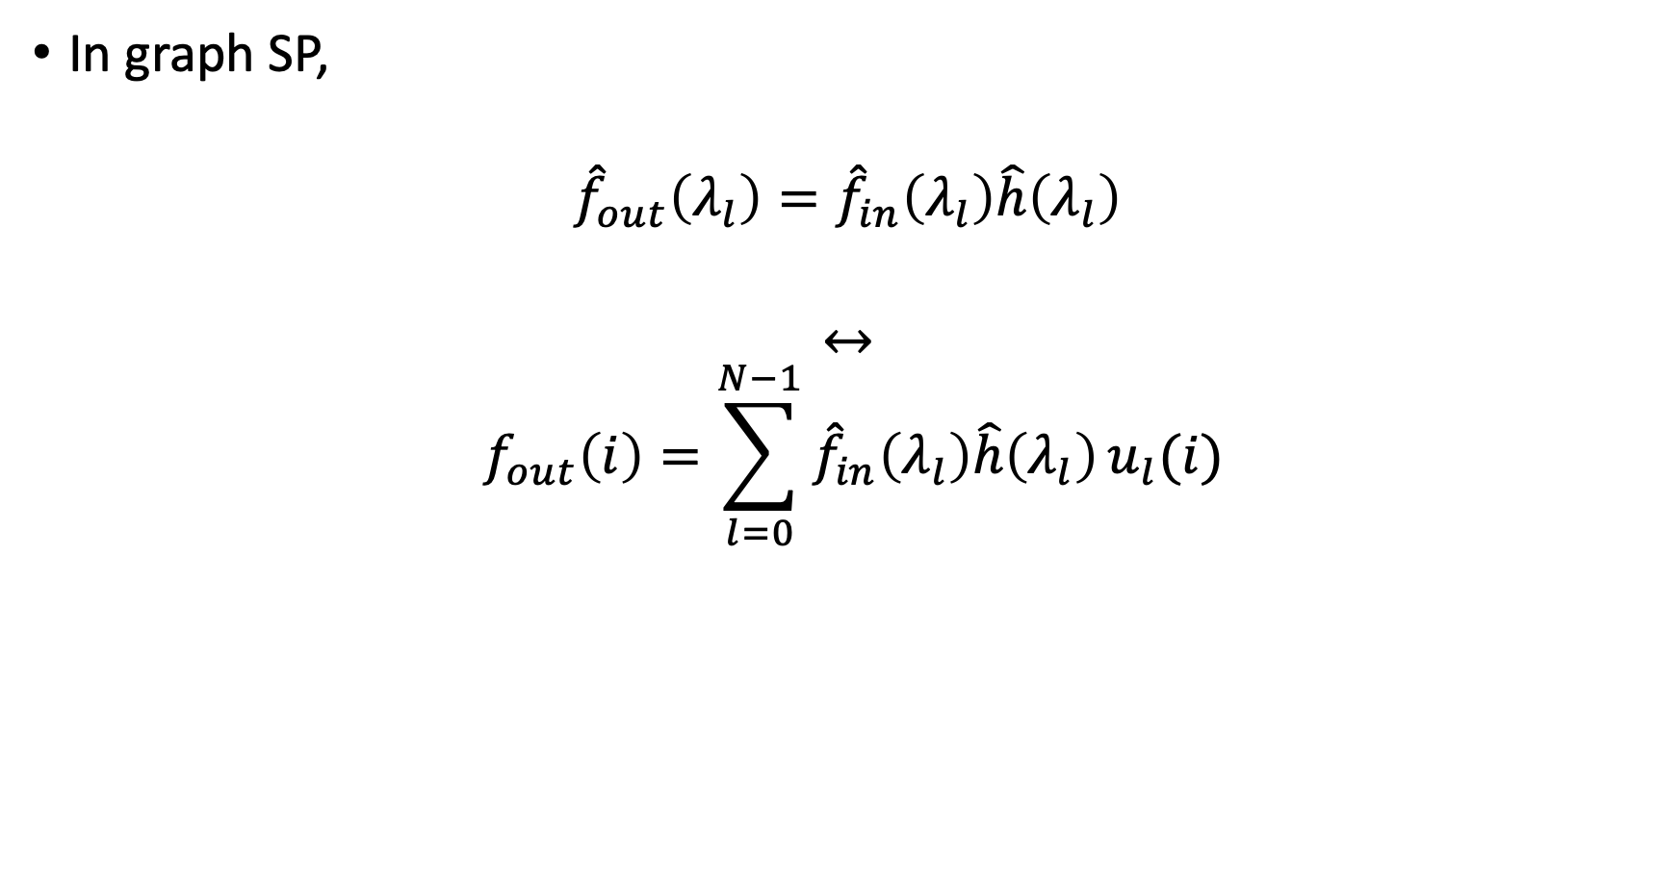
Frequency Filtering
In graph SP,
$${\hat{f}}_{out}\left(λ_{l}\right)={\hat{f}}_{in}\left(λ_{l}\right)\hat{h}\left(λ_{l}\right)$$
$$↔$$
$$f_{out}\left(i\right)=\sum_{l=0}^{N−1}{{\hat{f}}_{in}\left(λ_{l}\right)\hat{h}\left(λ_{l}\right)}u_{l}(i)$$

Slide 35
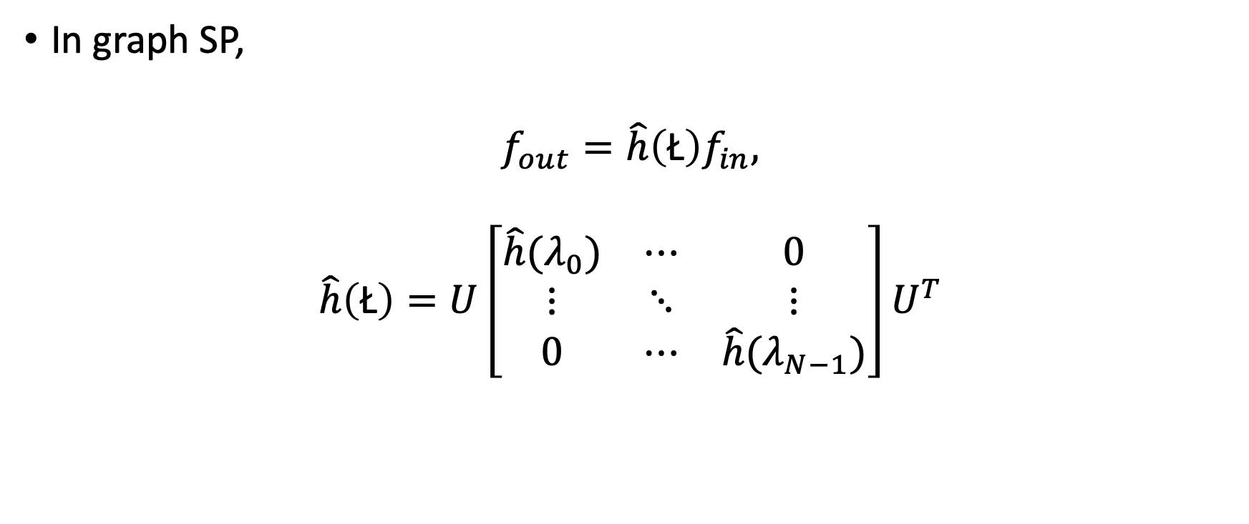
Frequency Filtering
In graph SP,
$$f_{out}=\hat{h}\left(\text{Ł}\right)f_{in},$$
$$\hat{h}\left(\text{Ł}\right)=U\left[\begin{matrix}\hat{h}(λ_{0}) & ⋯ & 0 \\ ⋮ & ⋱ & ⋮ \\ 0 & ⋯ & \hat{h}(λ_{N−1})\end{matrix}\right]U^{T}$$

Slide 36
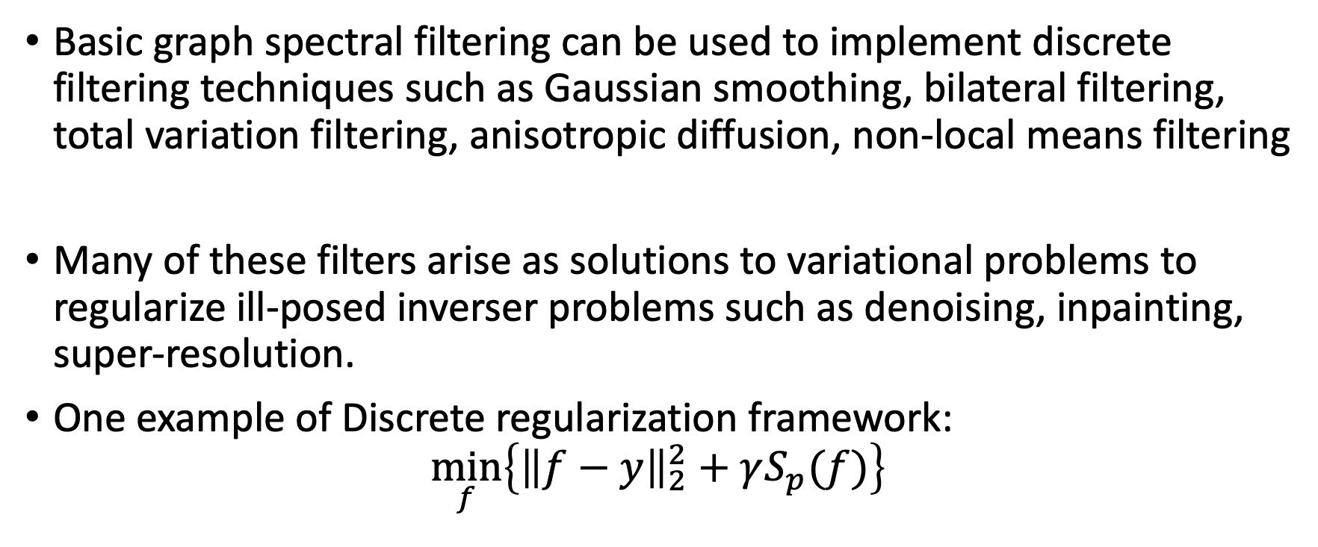
Frequency Filtering
Basic graph spectral filtering can be used to implement discrete filtering techniques such as Gaussian smoothing, bilateral filtering, total variation filtering, anisotropic diffusion, non-local means filtering
Many of these filters arise as solutions to variational problems to regularize ill-posed inverser problems such as denoising, inpainting, super-resolution.
One example of Discrete regularization framework:
$$\min_{f}\left\{{\left\|f−y\right\|}_{2}^{2}+γS_{p}(f)\right\}$$

Slide 37
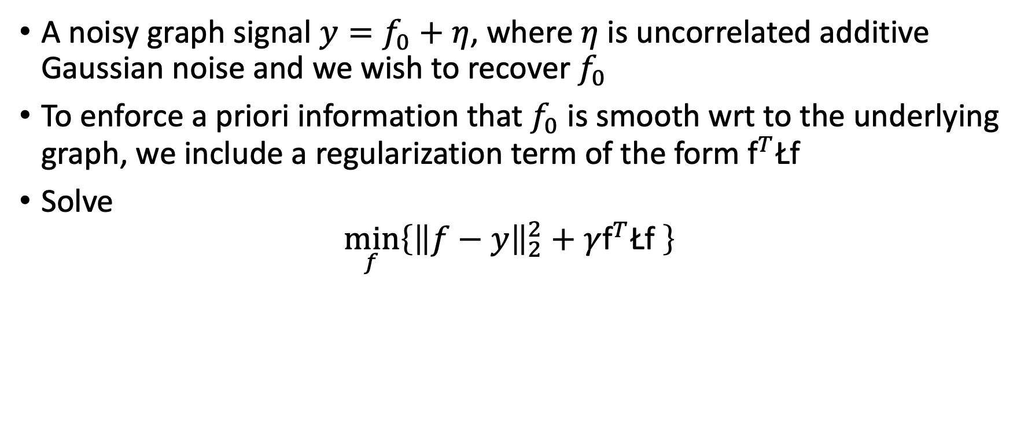
Example – Tikhonov Regularization
A noisy graph signal $y=f_{0}+η$, where $η$ is uncorrelated additive Gaussian noise and we wish to recover $f_{0}$
To enforce a priori information that $f_{0}$ is smooth wrt to the underlying graph, we include a regularization term of the form ${\text{f}}^{T}\text{Ł}\text{f}$
Solve
$$\min_{f}\left\{{\left\|f−y\right\|}_{2}^{2}+γ{\text{f}}^{T}\text{Ł}\text{f} \right\}$$

Slide 38
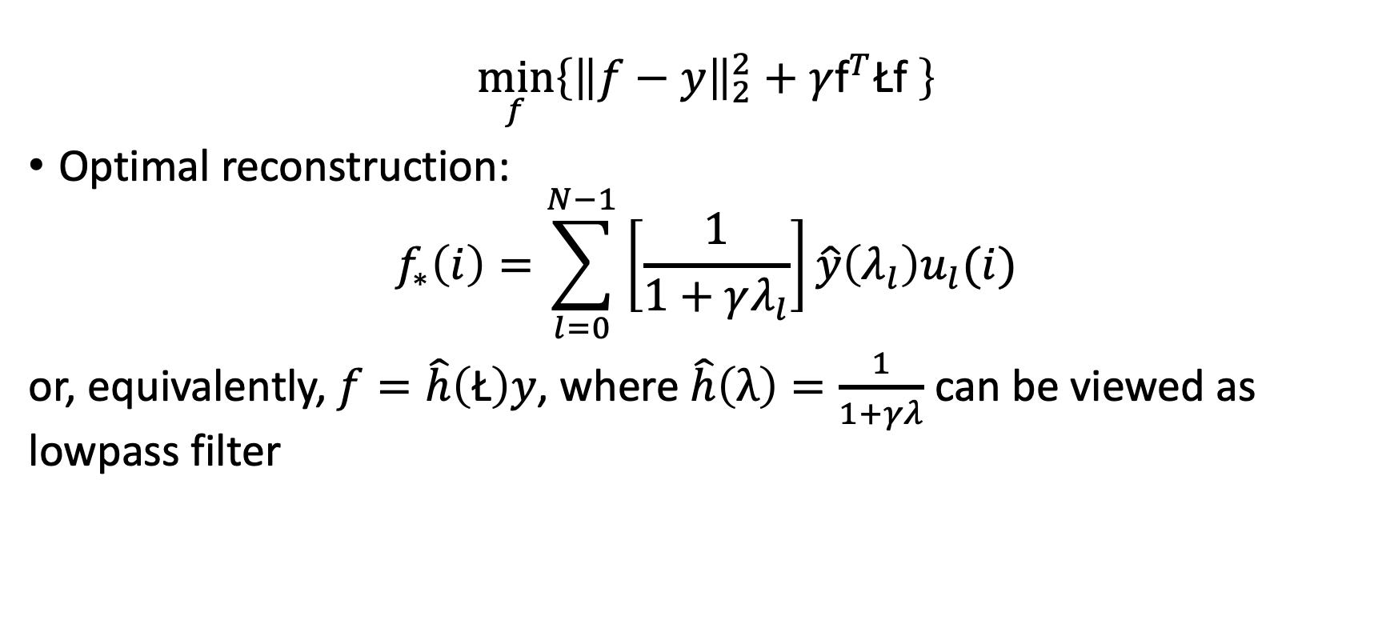
Example – Tikhonov Regularization
$$\min_{f}\left\{{\left\|f−y\right\|}_{2}^{2}+γ{\text{f}}^{T}\text{Ł}\text{f} \right\}$$
Optimal reconstruction:
$$f_{∗}\left(i\right)=\sum_{l=0}^{N−1}{\left[\frac{1}{1+γλ_{l}}\right]\hat{y}\left(λ_{l}\right)u_{l}(i)}$$
or, equivalently, $f=\hat{h}\left(\text{Ł}\right)y$, where $\hat{h}\left(λ\right)=\frac{1}{1+γλ}$ can be viewed as lowpass filter

Slide 39
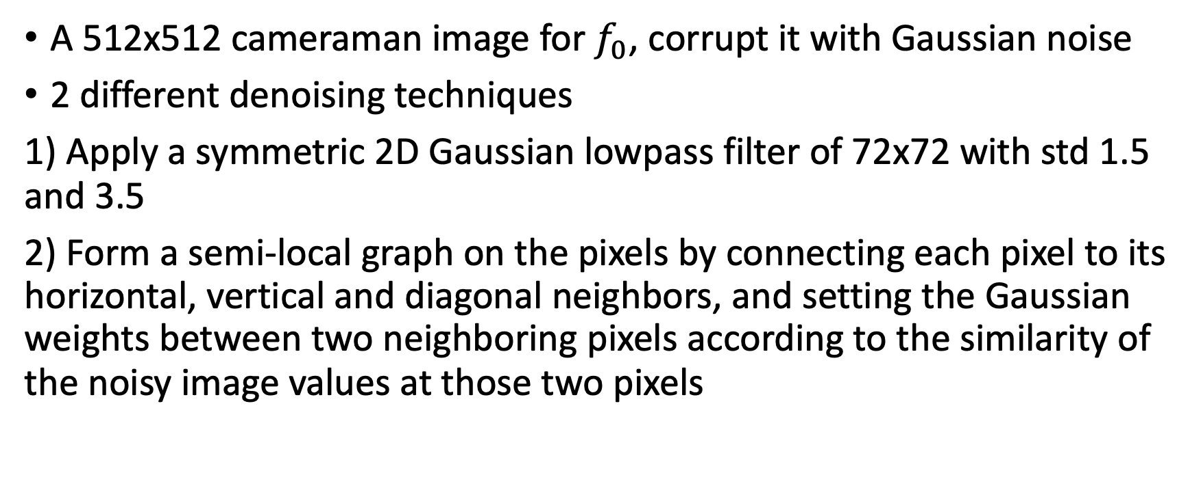
Example – Tikhonov Regularization
A 512x512 cameraman image for $f_{0}$, corrupt it with Gaussian noise
2 different denoising techniques
1) Apply a symmetric 2D Gaussian lowpass filter of 72x72 with std 1.5 and 3.5
2) Form a semi-local graph on the pixels by connecting each pixel to its horizontal, vertical and diagonal neighbors, and setting the Gaussian weights between two neighboring pixels according to the similarity of the noisy image values at those two pixels

Slide 40
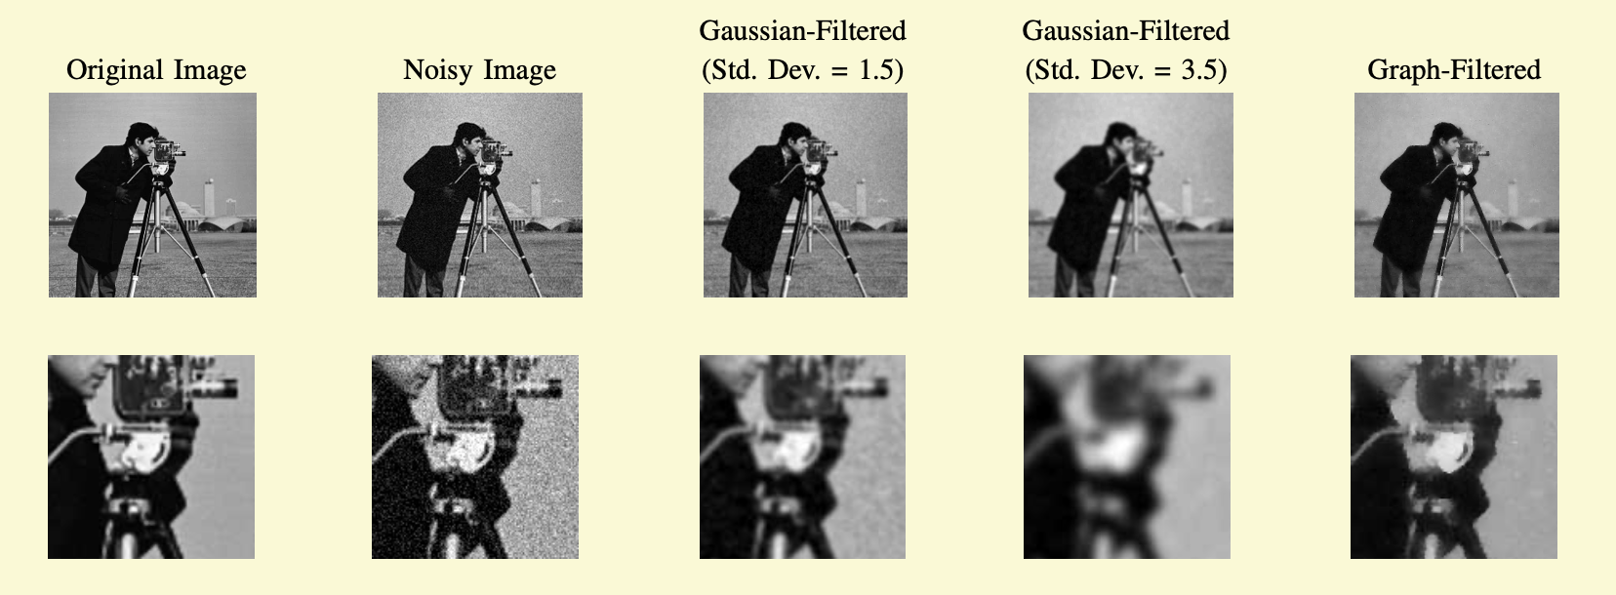
Example – Tikhonov Regularization

Slide 41
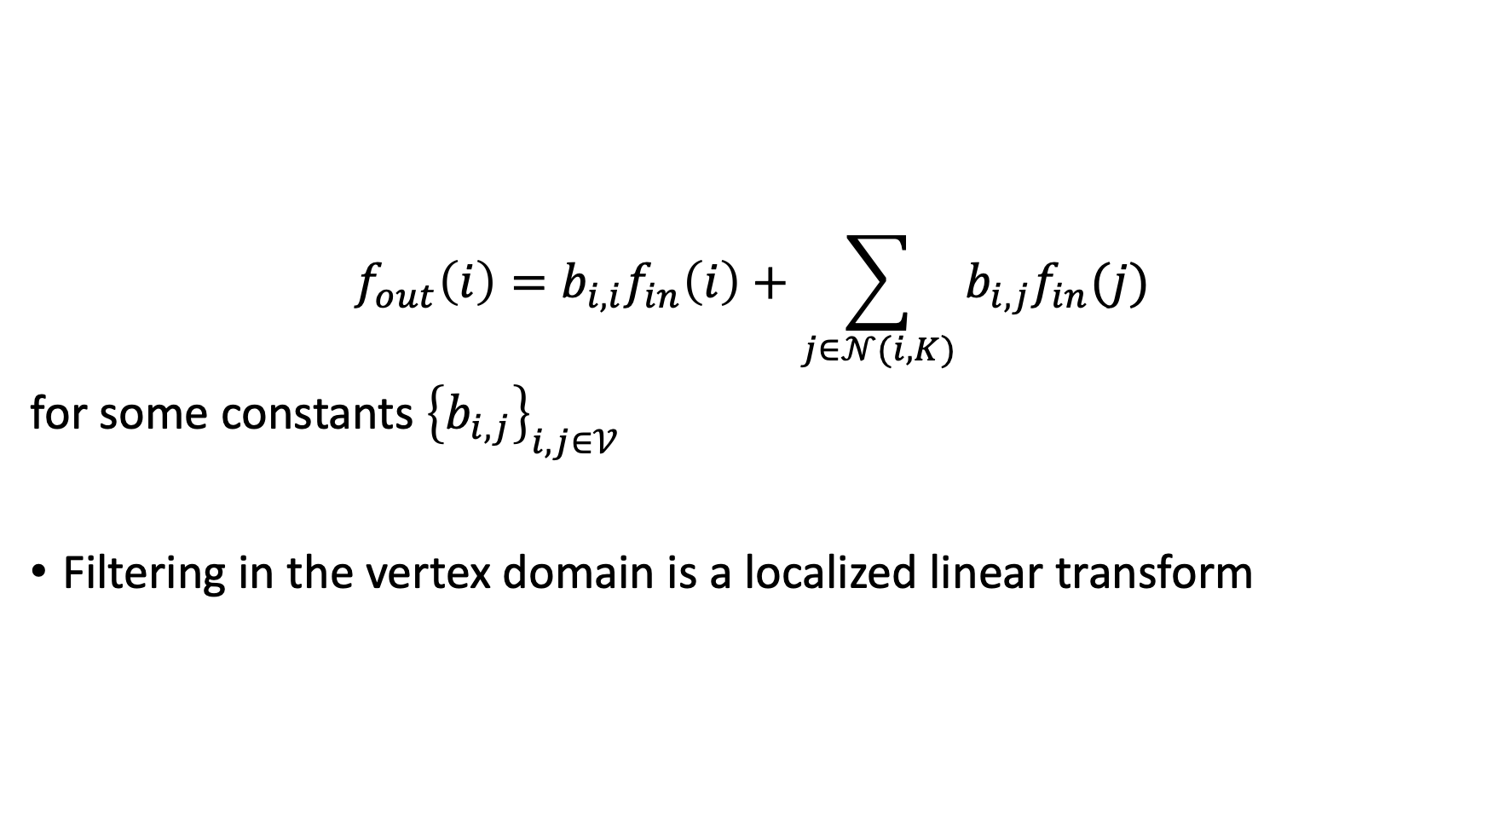
Filtering in the Vertex Domain
$$f_{out}\left(i\right)=b_{i,i}f_{in}\left(i\right)+\sum_{j∈𝒩(i,K)}{b_{i,j}f_{in}(j)}$$
for some constants ${\left\{b_{i,j}\right\}}_{i,j∈𝒱}$
Filtering in the vertex domain is a localized linear transform

Slide 42
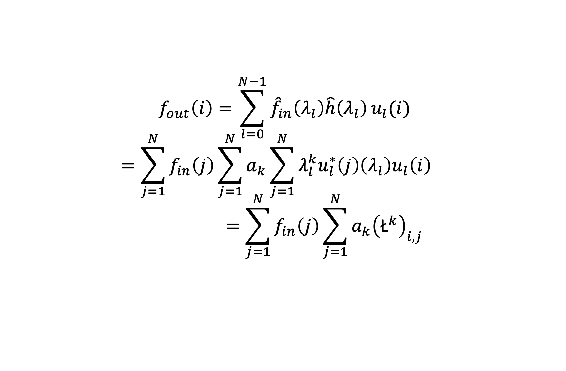
Filtering
$$f_{out}\left(i\right)=\sum_{l=0}^{N−1}{{\hat{f}}_{in}\left(λ_{l}\right)\hat{h}\left(λ_{l}\right)}u_{l}(i)$$
$$=\sum_{j=1}^{N}{f_{in}\left(j\right)\sum_{j=1}^{N}{a_{k}\sum_{j=1}^{N}{λ_{l}^{k}u_{l}^{∗}\left(j\right)\left(λ_{l}\right)u_{l}\left(i\right) }}}$$
$$=\sum_{j=1}^{N}{f_{in}\left(j\right)\sum_{j=1}^{N}{a_{k}{\left({\text{Ł}}^{k}\right)}_{i,j}}}$$

Slide 43
CNN on Graphs
Steps of generalizing CNNs to graphs:
The design of localized convolutional filters on graphs
Graph coarsening procedure that groups together similar vertices
Graph pooling operation that trades spatial resolution for higher filter resolution

Slide 44
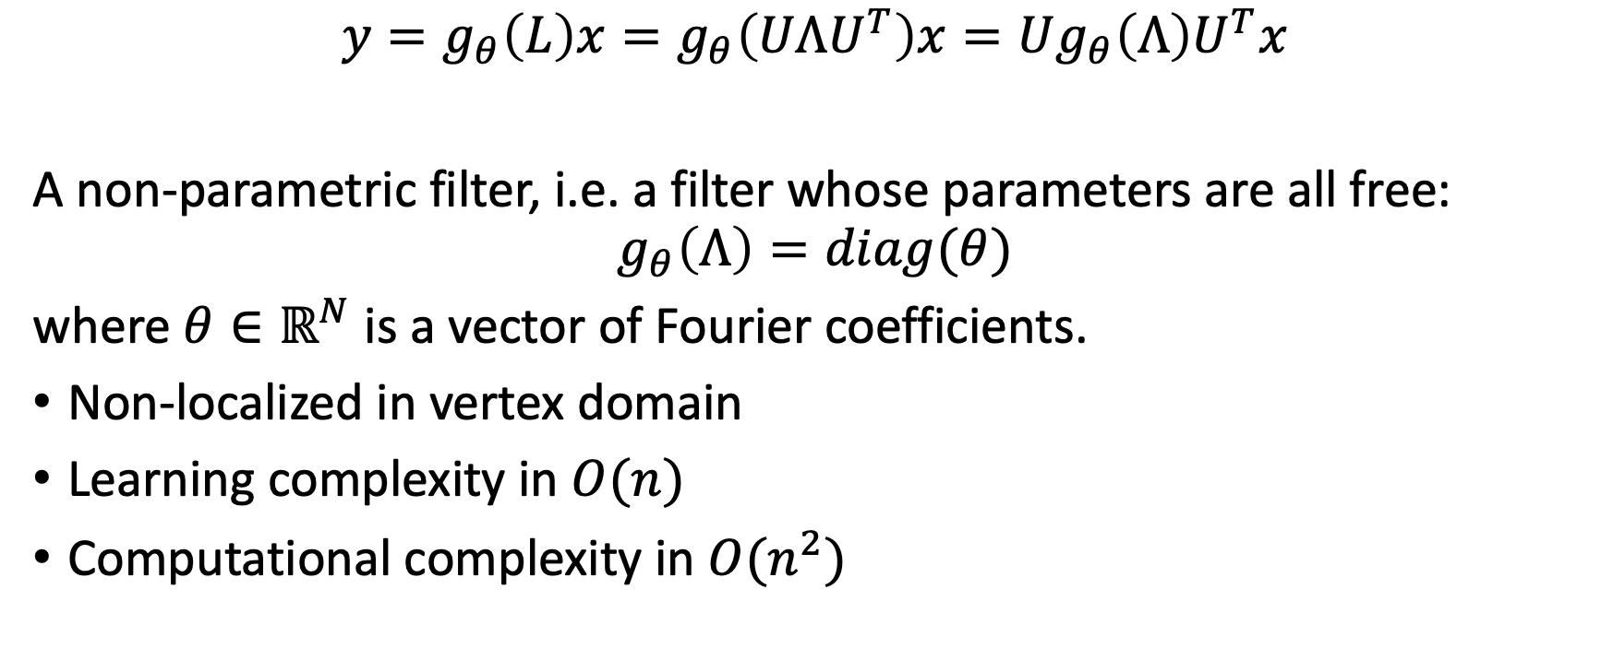
Spectral Filtering of Graph Signals
$$y=g_{θ}\left(L\right)x=g_{θ}\left(UΛU^{T}\right)x=Ug_{θ}\left(Λ\right)U^{T}x$$
A non-parametric filter, i.e. a filter whose parameters are all free:
$$g_{θ}\left(Λ\right)=diag(θ)$$
where $θ∈ℝ^{N}$ is a vector of Fourier coefficients.
Non-localized in vertex domain
Learning complexity in $O(n)$
Computational complexity in $O(n^{2})$

Slide 45
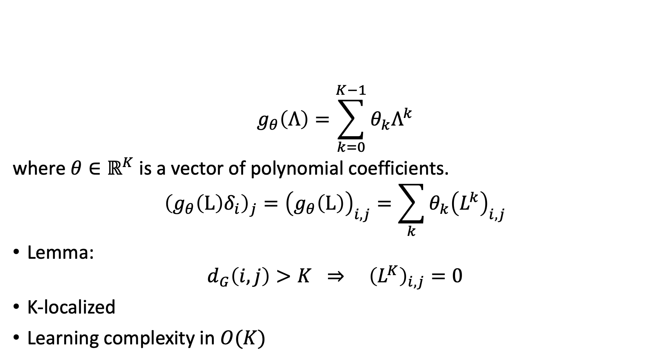
Polynomial Parametrization for Localized Filters
$$g_{θ}\left(Λ\right)=\sum_{k=0}^{K−1}{θ_{k}Λ^{k}}$$
where $θ∈ℝ^{K}$ is a vector of polynomial coefficients.
$${\left(g_{θ}\left(L\right)δ_{i}\right)}_{j}={\left(g_{θ}\left(L\right)\right)}_{i,j}=\sum_{k}{θ_{k}{\left(L^{k}\right)}_{i,j}}$$
Lemma:
$$d_{G}\left(i,j\right)>K ⇒ {\left(L^{K}\right)}_{i,j}=0$$
K-localized
Learning complexity in $O(K)$

Slide 46
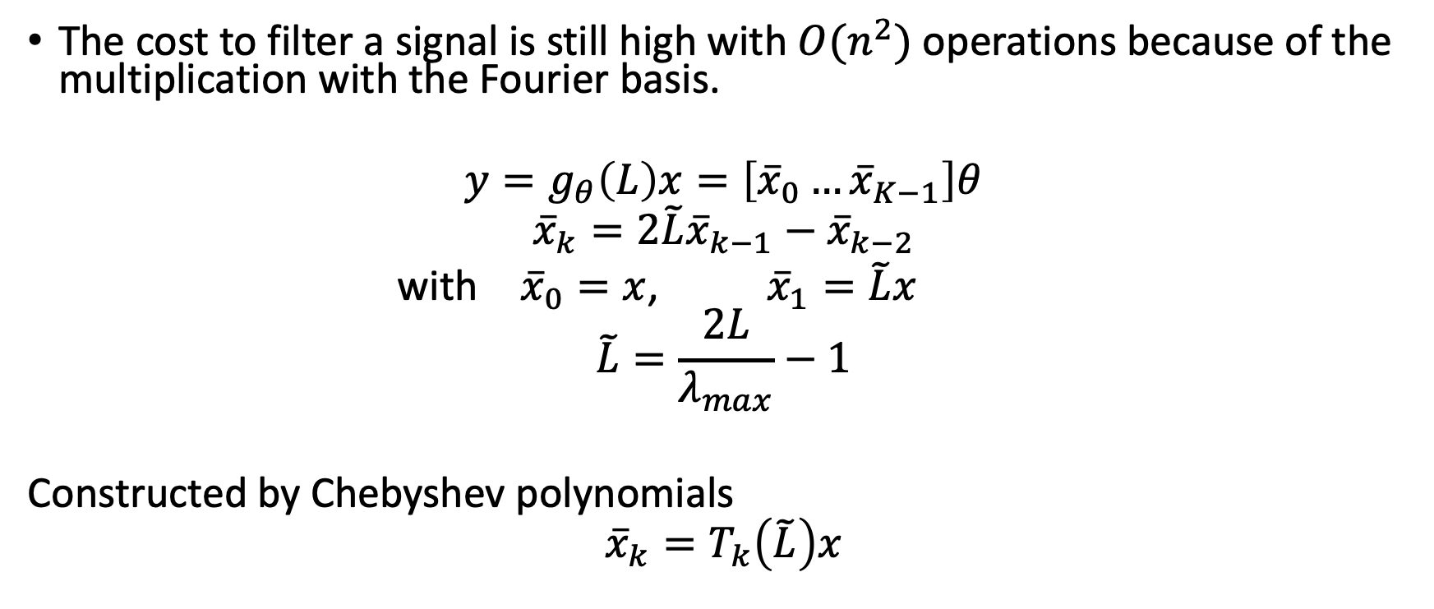
Recursive Formulation for Fast Filtering
The cost to filter a signal is still high with $O(n^{2})$ operations because of the multiplication with the Fourier basis.
$$y=g_{θ}\left(L\right)x=\left[{\overline{x}}_{0}…{\overline{x}}_{K−1}\right]θ$$
$${\overline{x}}_{k}=2\tilde{L}{\overline{x}}_{k−1}−{\overline{x}}_{k−2}$$
with ${\overline{x}}_{0}=x$, ${\overline{x}}_{1}=\tilde{L}x$
$$\tilde{L}=\frac{2L}{λ_{max}}−1$$
Constructed by Chebyshev polynomials
$${\overline{x}}_{k}=T_{k}\left(\tilde{L}\right)x$$

Slide 47
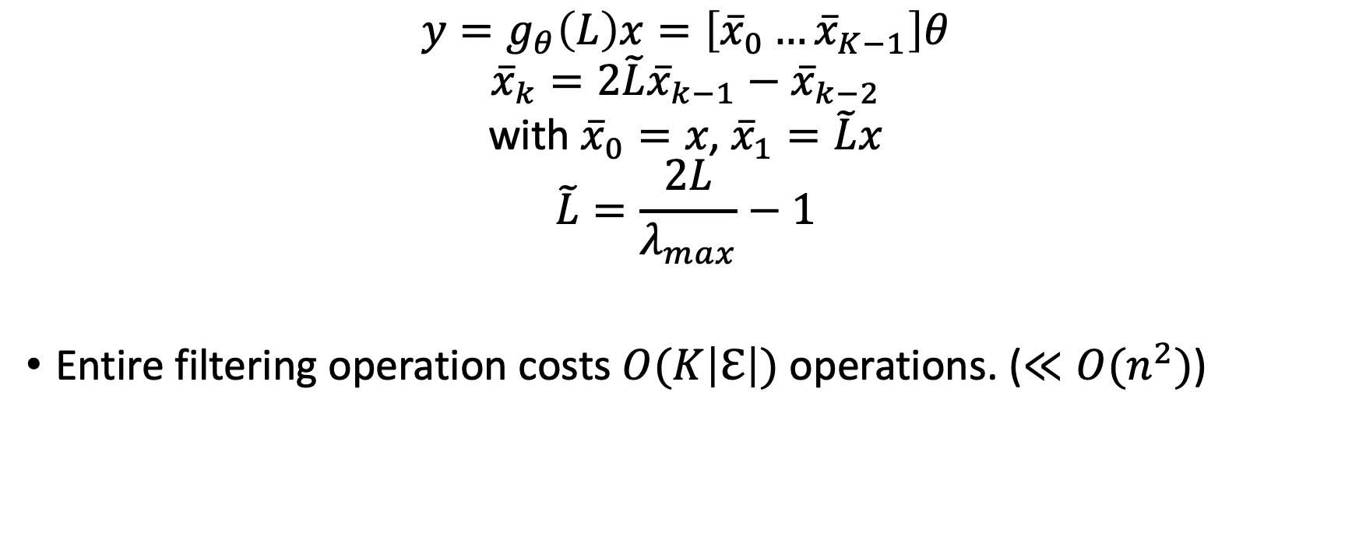
Recursive Formulation for Fast Filtering
$$y=g_{θ}\left(L\right)x=\left[{\overline{x}}_{0}…{\overline{x}}_{K−1}\right]θ$$
$${\overline{x}}_{k}=2\tilde{L}{\overline{x}}_{k−1}−{\overline{x}}_{k−2}$$
$$\text{w}\text{ith} {\overline{x}}_{0}=x\text{, }{\overline{x}}_{1}=\tilde{L}x$$
$$\tilde{L}=\frac{2L}{λ_{max}}−1$$
Entire filtering operation costs $O(K\left|ℇ\right|)$ operations. ($≪O(n^{2})$)

Slide 48
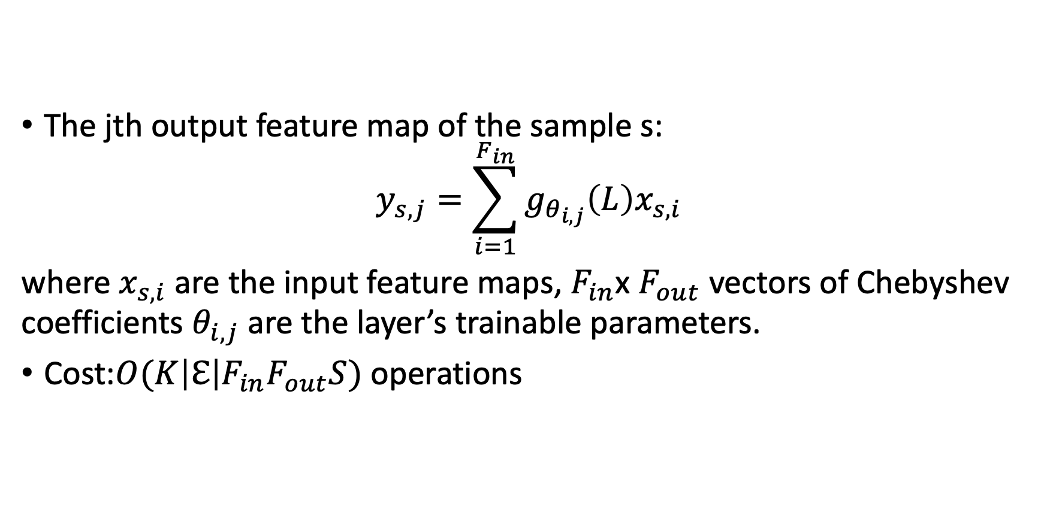
Learning Filters
The jth output feature map of the sample s:
$$y_{s,j}=\sum_{i=1}^{F_{in}}{g_{θ_{i,j}}\left(L\right)x_{s,i}}$$
where $x_{s,i}$ are the input feature maps, $F_{in}$x $F_{out}$ vectors of Chebyshev coefficients $θ_{i,j}$ are the layer’s trainable parameters.
Cost:$O(K\left|ℇ\right|F_{in}F_{out}S)$ operations

Slide 53
Graph Coarsening
…

Slide 54
Wednesday 10h Meeting with Joan

